Slide 1
IEEE Computer Society, Swedish Chapter
Kristian Sandahl
2024-10-31

Slide 2
Nationally we call ourselves the IEEE Computer/Software Engineering Chapter

Slide 3
Members
Board:
Kristian Sandahl, LiU, chair
Simone Fischer-Hübner, KAU, vice chair
Secretary vacant
Greger Wikstrand, Capgemeni
Jonas Melin, HiS, membership development
172 Members in March, a few more came in later.

Slide 4
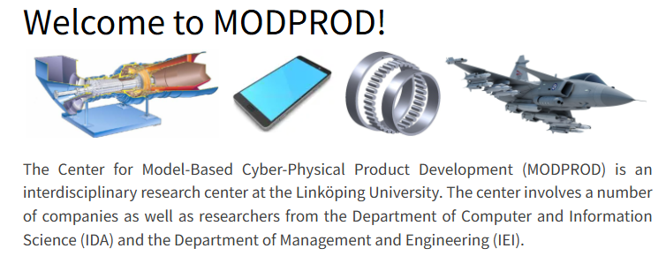
MODPROD 2024
172 Members in March, a few more came in later.
February 7-8, 16th MODPROD Workshop on Model-Based Cyber-Physical Product Development, Linköping
50+ participants

Slide 5
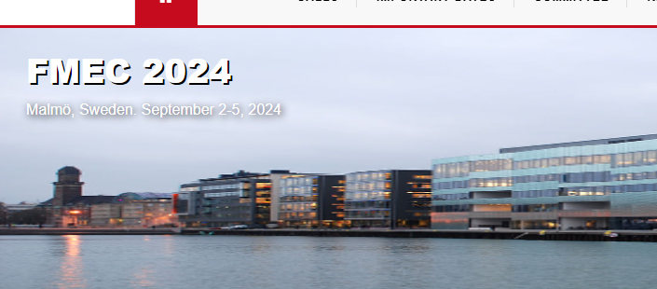
FMEC 2024
The 9th International Conference on Fog and Mobile Edge Computing
(FMEC 2024)
Malmö, Sweden. September 2-5, 2024
40+ participants

Slide 6
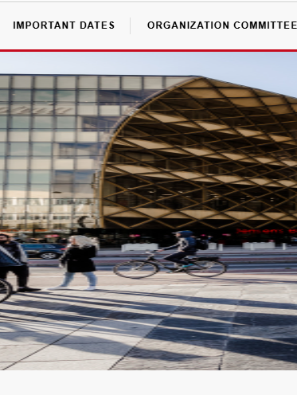
IOTSMS 2024
The 11th International Conference on Internet of Things: Systems, Management and Security (IOTSMS 2024)
Malmö, Sweden. September 2-5, 2024
30+ participants

Slide 7
Problems
Low member engagement
Better offer for non-US members
I will be retiring

Slide 8
Opportunities
Revitalize the chapter!
Four volunteers for a board found, including Anas Dakkak as chair!
We need seed money 20 000 is reasonable.

