Slide 1
IEEE Sweden Section Member Development
---Ming Xiao, EECS, KTH

Slide 2
Outline
Member Overview
Analysis
Campaign

Slide 3
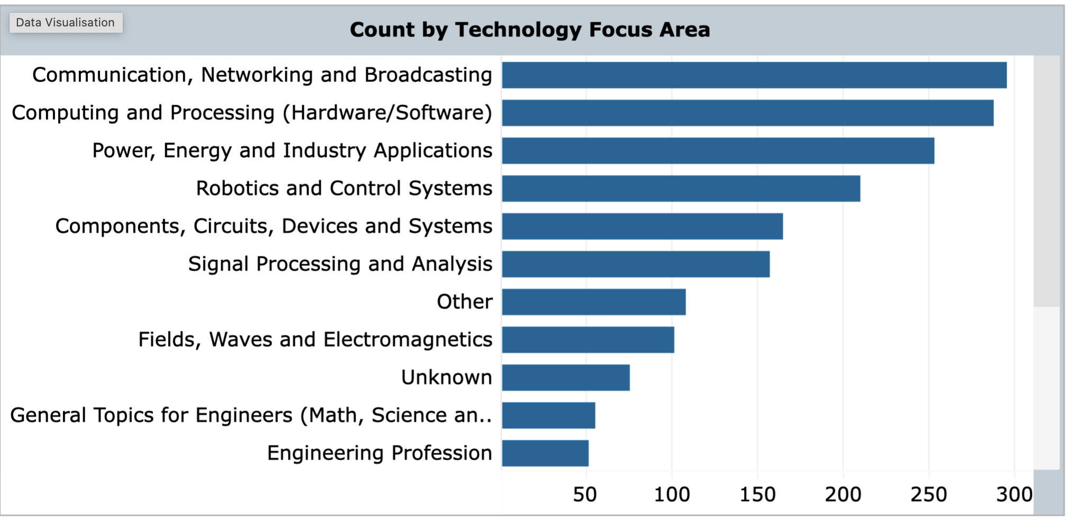
Member Overview
Upto October 2024, total number of member: around 1932 (1918 in year 2023)

Slide 4
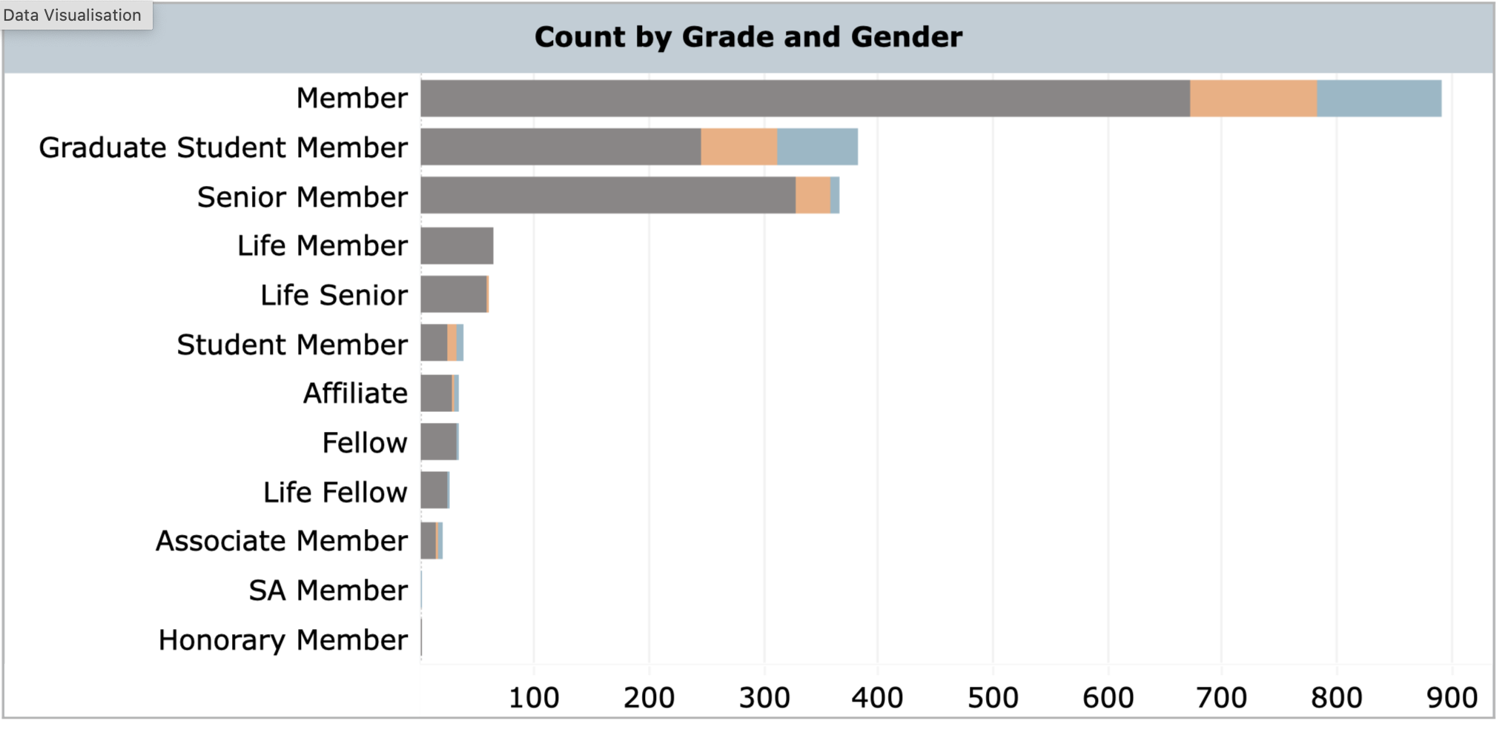
Member Overview
Upto October 2024, 61 IEEE Fellows (+life Fellows), 430 senior member (+life), 25% Fellow + Senior member: The quality/grade of Sweden Section is rather high.

Slide 5
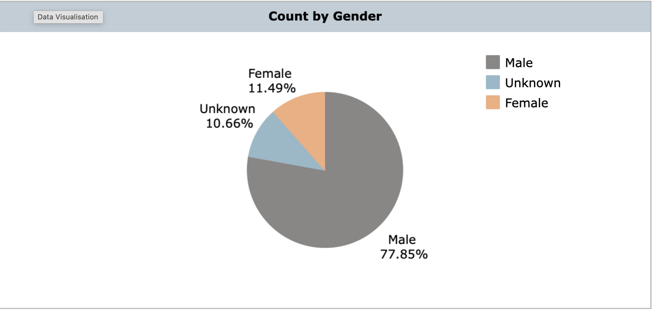
Member Overview
Upto October 2024, Female Member should be further developed.

Slide 6
Analysis
Member by month

Slide 7
Analysis
Member by month
The total number is slightly increasing year-by-year in recent a few years.
IEEE total increase seems larger: 436103 (Sept. 2024), yearly increase 3.6%. But the higher grade member is rather high.
In all IEEE, the Fellow (+life) + Senior (+life) is about 12% (about 55000). Sweden is about 25%.

Slide 8
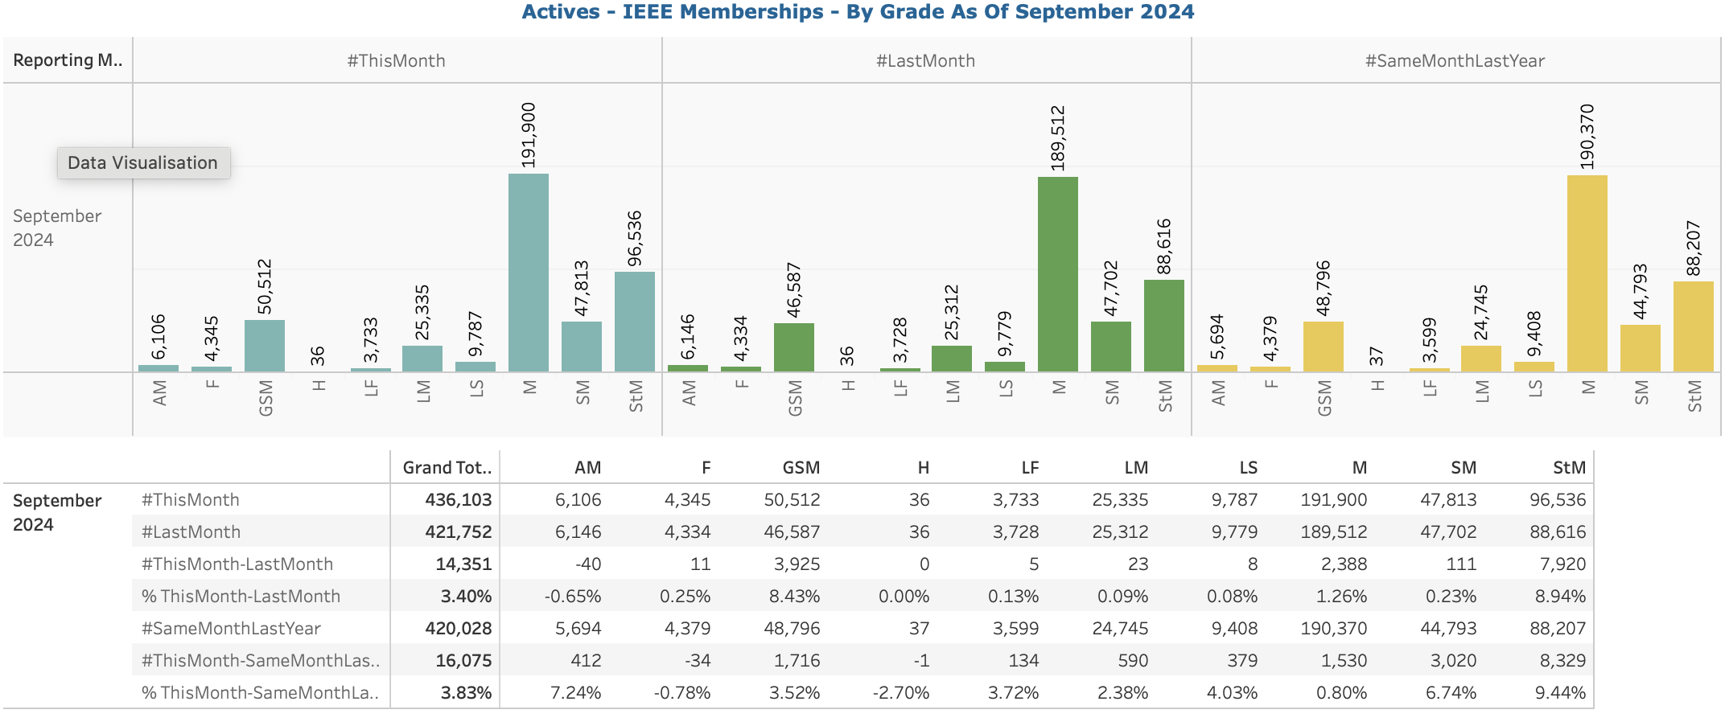
Campaign
Objective: To attract new member and keep exsited member.
Method:
1. Senior member campaign. Help Member to become SM as references etc.
2. Student activities (can quickly
increase Figures. But may not be varying).
3. much more efforts should be put
to develop female members.

Slide 9
Questions and Suggestion?

