Slide 1
IEEE Photonics Society
Sweden Chapter
IEEE Sweden Section
Chapter Chair Workshop (CCW) 2023
31-Oct-2024 (rev. A)
Hybrid meeting (Linköping Univ. & Zoom)
Arne Alping, PhD, Docent, IEEE Senior Member
Chapter Board Chair
Member of the IEEE Sweden Section NOM Committee
Member of IEEE PS, MTT-S, ComSoc, and SSCS
Member of IEEE Standards Association (SA)
Member of PhotonicSweden, SOS, EOS, and Photonics21
arne.alping@ieee.org
Link to IEEE PS-Sweden web site

Slide 2

IEEE Photonics Society
Overview & benefits
The Photonics Society is part of the IEEE (460 000+ members).
It is the world’s largest technical professional organization dedicated to advancing technology for the benefit of humanity
Our vibrant technical community of 100,000+ professionals is dedicated to transforming breakthroughs in quantum physics into the devices, systems and products we use in our daily lives. From ubiquitous and inexpensive global communications via fiber optics, to lasers for medical and other applications, to flat-screen displays, to photovoltaic devices for solar energy, to LEDs for energy-efficient illumination, there are myriad examples of the society’s impact on the world around us.
The Society provide members with professional growth opportu-nities, publish journals, sponsor conferences and support local chapter and student activities around the world.
IEEE Photonics Society Sweden Chapter
40 members (65% univ & institutes, 35% companies)
IEEE Photonics Society
Reduced conference fees
Open access publishing discount (15%)
Free full, online access to IEEE-PS journals:
  IEEE Photonics Journal
  IEEE Photonics Technology Letters
  IEEE Journal of Quantum Electronics
  IEEE Journal of Selected Topics in Quantum Electronics
  IEEE/OSA Journal of Lightwave Technology
  IEEE/OSA Journal of Optical Communications & Networking
  IEEE/OSA Journal of Display Technology
Free online access to all IEEE PS-sponsored conference proceedings

Slide 3
IEEE Photonics Society – Sweden Chapter
Board members (7)
Chair: Dr. Arne Alping, MWP tech consulting
Vice Chair: Prof. Philippe Tassin, Chalmers Univ. of Tech.
Secretary: Prof. László Veisz, Umeå University
Treasurer: Vacant
Webmaster: Dr. Rui Lin, Chalmers Univ. of Tech
MDO: Dr. Xiaodan Pang, KTH
WIP/WIE: Prof. Qin Wang, RISE/KTH
Dr. Shagufta Naureen, Coherent Corp.
PhD Thesis Award: Prof. Philippe Tassin, Chalmers Univ. of Tech.
Newsletter Editor: Dr. Arne Alping, MWP tech consulting
5-8 Board meetings per year
All Board meetings are virtual using MS Teams
MDO = Member Development Officer
WIP/WIE = Women in Photonics/Engineering

Slide 4
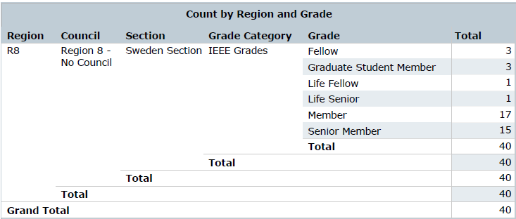
IEEE Photonics Society – Sweden Chapter
Membership statistics (1/2)
Membership statistics extracted from “IEEE OU Analytics” [15-Sept-2024]
Currently the total number of members is 40 [-1 since Jan-2024]
Gender: In total 6 female (15%) [+1 since Jan-2024] and
3 of them are Board members (i.e., 43% of the Board)
Senior members: 16 [-1 since Jan-2024]
Student members: 3 student members [-1 since Jan-2024] (>300 student members in Sweden)

Slide 5
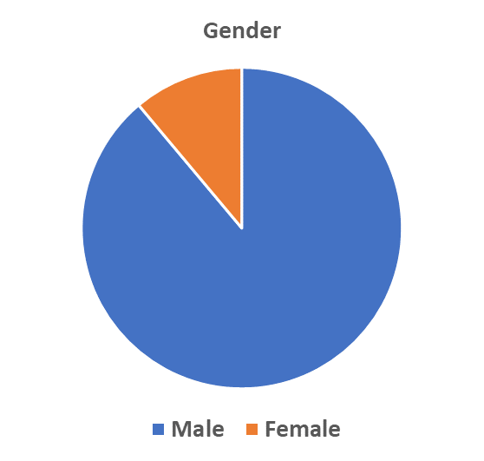
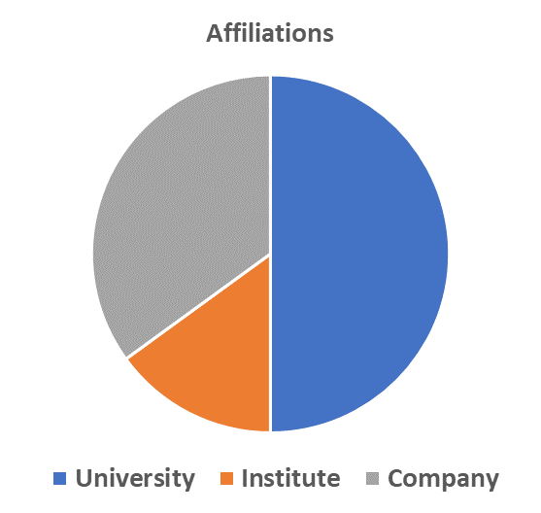
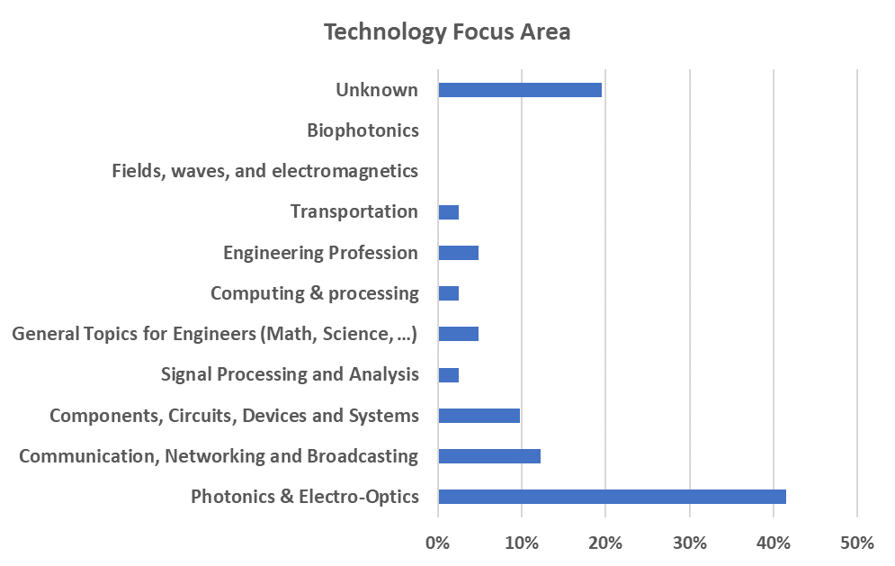
IEEE Photonics Society – Sweden Chapter
Membership statistics (2/2)
14%
27%
55%
88%
18%
Number of members: 40 (14% female)
Note that, in Sweden for the last 10 years, only 10% are female of
the MS students examined in engineering physics and electrical engineering¹⁾
Number of Board members: 7 (43% female)
27% companies and 73% universities/institutes
Statistics from IEEE OU Analytics (2024-09-15)
¹⁾ UKÄ report 2020-03-23

Slide 6
IEEE Photonics Society – Sweden Chapter
Mission related activities 2023/2024
Technology areas
  Covering lasers, fiber-optics, bio-photonics, displays, solar energy conversion, LED illumination, …
Recognitions (Award programs)
  Annual Best PhD Thesis Awards
    2023: Dr. Max Karlsson, Linköping University; Award was 10,000 SEK (winner announced in March-2024)
    2024: Nomination period ends 30-Nov-2024; Award is 10,000 SEK
  Best Poster Awards (3x) at the Swedish annual OPS-2024 conference
    This year only students and post-docs are eligible for the Award
    The students winning an Award are offered a free 1-year IEEE student membership
Sponsoring Women-in-Photonics (WIP) events
  Celebration of Nobel Prize 2023 – an IEEE WIP event [7-Dec-2023]
Sharing with Chapter members, Section members, and IPS members
  Through publishing quarterly Chapter Newsletters and contributions to Section and Society Newsletters
Events to support involvement with local industry, institutes, and universities
  OptoPub in Stockholm is co-organized with PhotonicSweden (14-Dec-2023 and planning for Dec-2024)
Professional development
  OptoPub (physical/virtual & mingle) & technical webinars (e.g., newly graduated PhDs)

Slide 7
IEEE Photonics Society – Sweden Chapter
Newsletters
Issuing schedule: Intention is once per quarter
(so far 23 issues since the start in 2019)
Distribution: To all IEEE-PS-Sweden members
Content of current Newsletters
  Presentation of IPS-Sweden events & activities
  Presentation of members lab, department, company (This is My Lab …)
  Presentation of recently defended PhD theses
  Presentation of photonics related news
  Presentation of photonics related resources
  Presentation of the IPS-Sweden Board members
  Summaries of attended conferences, workshops, meetings, etc.
  Announce nomination for IPS-Sweden sponsored workshops
  Announcing & reporting from IPS-Sweden Best PhD Thesis Award
  Announcing & reporting from IPS-Sweden sponsored workshops, etc.
  Announcement of upcoming events, conferences, workshops, etc.
  (not necessarily sponsored by IEEE, but of interest for our members)
Possible content in future Newsletters
  Presentation of recently started PhD students (photo & short description)
  Presentation of new faculty and new jobs of IPS-Sweden members

Slide 8
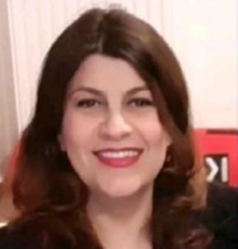
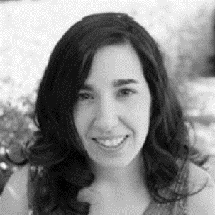
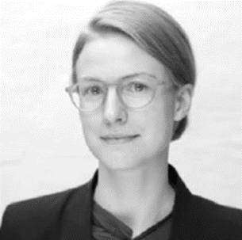
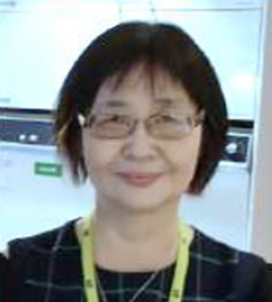

IEEE PS Sweden – Sweden Chapter
Celebration of Nobel Prize 2023 – an IEEE WIP event
Dec
2023
This year the Nobel Prize was awarded to scientists that have conducted research
in areas (Physics and Chemistry) that also have implications in the optics and photonics fields. Furthermore, there is also an unusual large number of women
that has been awarded this year.
This is the background to an IEEE Women-in-Photonics (WIP) initiative for a celebration of the Nobel Prize 2023. The event was organized by Prof. Qin Wang (RISE/KTH) and Dr. Shagufta Naureen (Coherent)
Coffee and cinnamon buns was served for all participants, free of charge. This hybrid event took place at RISE in Kista on 7-Dec-2023 at 14:00pm and was sponsored by IEEE Photonics Society Sweden Chapter and RISE
At this event, experts working in related fields at RISE were presenting this year’s Nobel Prize:
  14:00 Welcome speech, Dr. Björn Samel
  14:10 Introduction of the Nobel Prize in Physics, Dr. Nazila Safari Yazd
  14:15 Introduction of the Nobel Prize in Chemistry, Dr. Laia Gines
  14:20 Introduction of the Nobel Prize in Physiology or Medicine, Dr. Caroline Dahl
  14:25 Introduction of the Sveriges Riksbank Prize in Economic
  Sciences in Memory of Alfred Nobel 2023, Dr. Qin Wang
  14:30 Discussion
  14:45 End

Slide 9
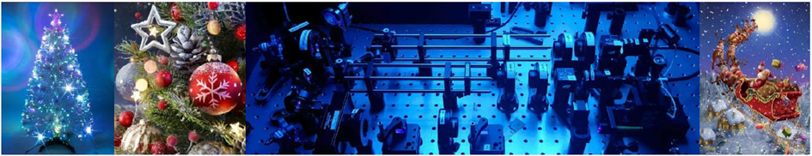
IEEE PS Sweden – Board meeting
OptoPub in Stockholm
Dec
2023
This on-site only event was co-organized with PhotonicSweden
Venue: RISE in Kista on 14-Dec-2023 at 17:30pm to 21:00pm
Local hosts: Lennart BM Svensson (PhotonicSweden) and Qin Wang (IEEE/RISE)
Agenda
  Anastasiia Andriievska (Dept. Computer Science, RISE),
  “Quantum Integrated Information Theory & Quantum Neuromorphic systems”
  Dr. Laia Ginés (Dept. Smart Hardware, RISE),
  “The rise of Quantum Technologies: From Quantum Computing to Secure Quantum Communication”
  Dr. Max Widarsson (CEO, SLF-Svenska Laserfabriken AB), “Entangled Photon Pair generation with periodically poled crystals”
  Dr. Arne Alping (Chair, IEEE-PS-Sweden) on “Introduction to IEEE and the 10th Anniversary”
  Followed by OptoPub:
  IEEE Photonics Society Sweden Chapter invites everyone who is pre-registered to
  mingle with food and drinks

Slide 10
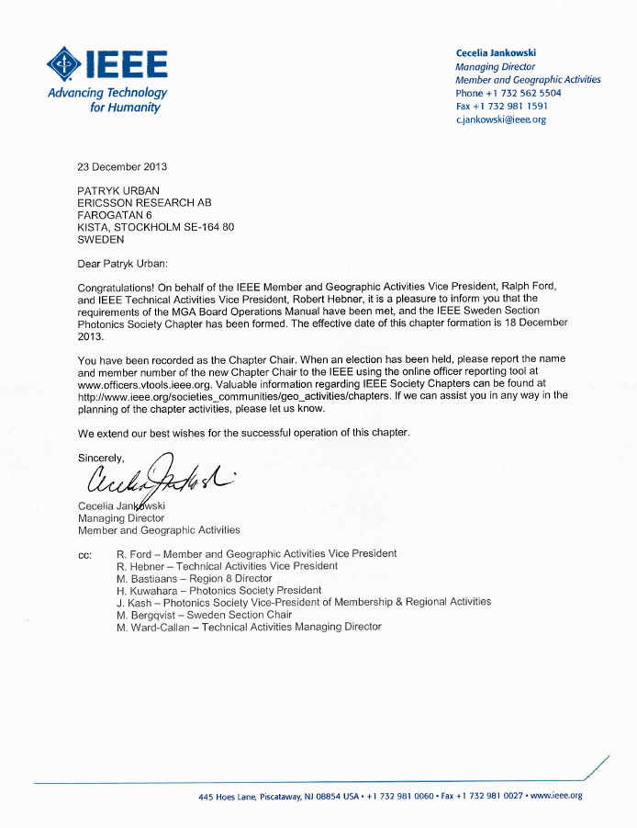
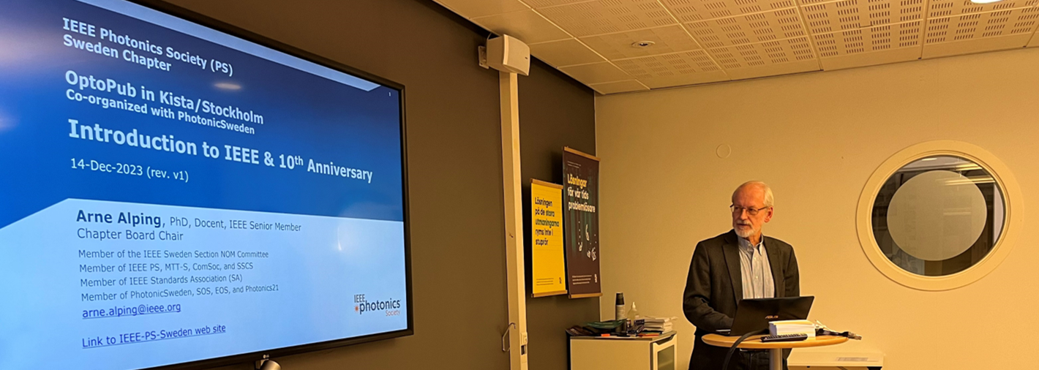
IEEE PS Sweden – Board meeting
Sweden Chapter 10-Year Anniversary
Dec
2023
On 18 December 2013 the Sweden Chapter was approved by IEEE MGA (Member and Geographic Activities)
Dr. Patryk Urban was the first Chair of the Chapter
(then at Ericsson Research, Sthlm, and now Associate Professor and
Head of Optical Reference Network Laboratory at West Pomeranian
University of Technology in Szczecin, Poland)
Celebration at the OptoPub in Sthlm on 14-Dec-2023
  IEEE-PS-Sweden is sponsoring the mingle with food and drinks with the addition of a celebration cake
  Special invitation to present and past Chapter Board members

Slide 11
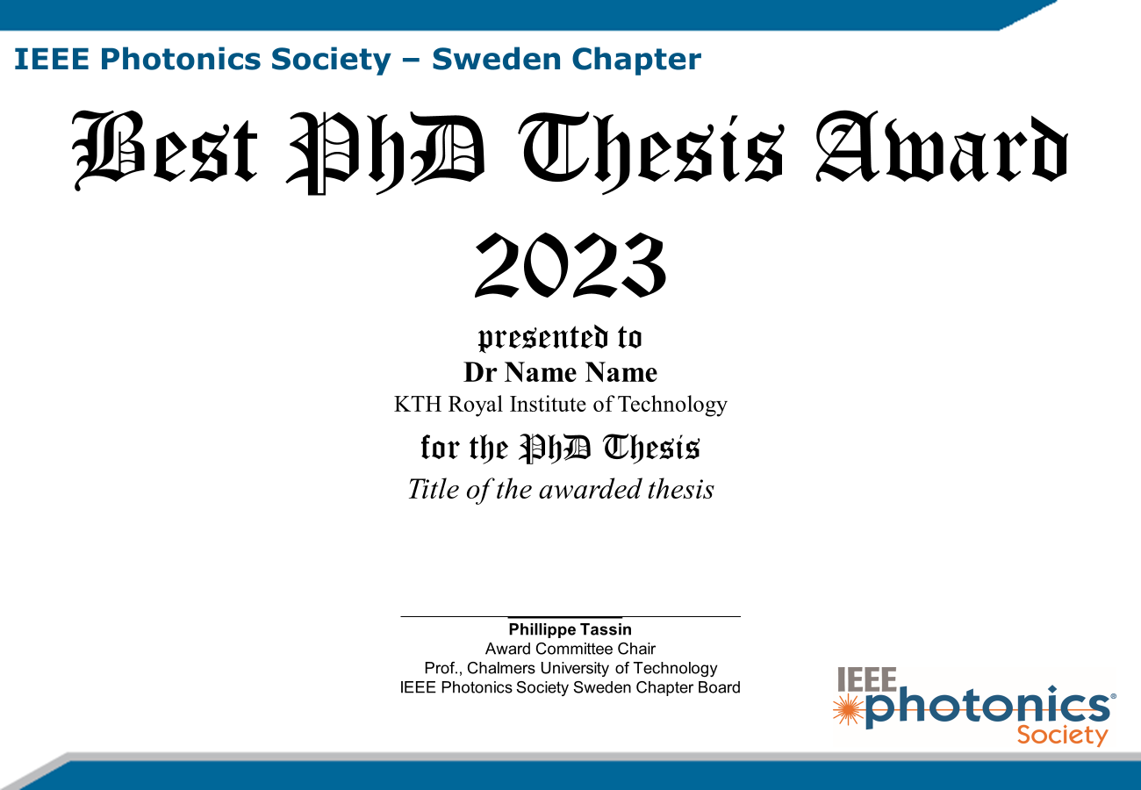
IEEE Photonics Society – Sweden Chapter
IEEE Best PhD Thesis Award 2023
March
2024
The IEEE-PS Sweden Chapter’s 2023 IEEE Best PhD Thesis Award in Optics/Photonics was closed for nominations on 30-Nov-2023. Decision on 13-March-2024 and payout on 26-March-2024.
The 2023 Award amounted 10,000 SEK and a certificate. The Award was funded through the IEEE Photonics Society 2023 Annual Chapter Grant.
The chair of the IEEE Best PhD Thesis Award Committee was Prof. Philippe Tassin, Chalmers
The Award has been granted to Dr. Max Karlsson (Dept. of Physics, IFM, Div. of E & P Materials, Linköping University; now at Thorlabs, Gothenburg) for his thesis entitled “Dynamics in Blue Emitting Metal Halide Perovskites for Light Emitting Diodes”. The supervisors were Prof. Feng Gao & Prof. Tze Chien Sum
The Award committee’s motivation is: “The Best PhD Thesis Award is this year awarded to Dr. Max Karlsson for his thesis on metal halide perovskites for LEDs emitting in the blue. This thesis explains, in a pedagogic way, the historic development and state of the art of the field, before continuing with a summary of Dr. Karlsson’s work, providing valuable insights into the fundamental mechanisms governing the optical properties of perovskites, especially related to stability issues, paving the way for advancements in the design and optimization of perovskite-based devices. Overall, the thesis demonstrates that Dr. Karlsson has an in-depth understanding of his field and is able to convey that understanding to people outside his field”.
The Awards committee also hopes that this thesis can serve as a good examp­le for doctoral students
in the early stages of their own thesis writing.
Max Karlsson has also been granted a similar award – the Oseen Medal 2024 – from the Swedish Physical Society. The prize consists of a medal, diploma, and a cash award of 100,000 SEK.

Slide 12
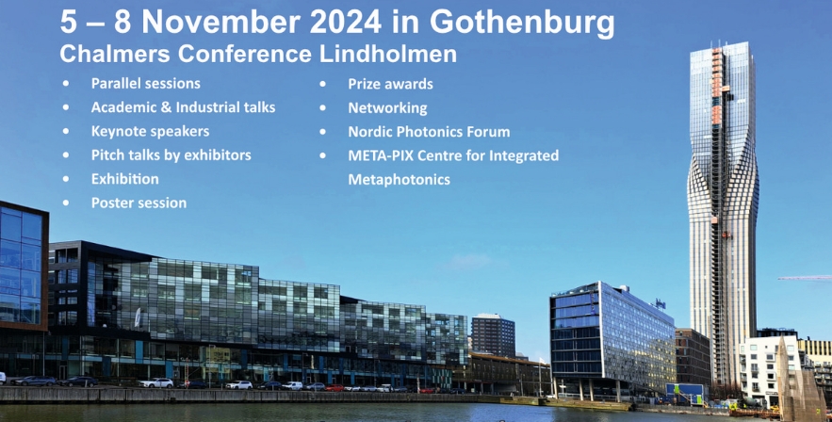
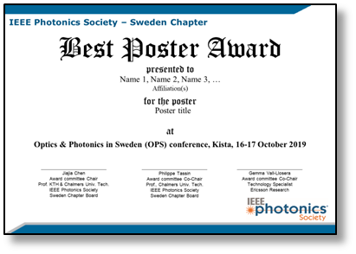
IEEE Photonics Society – Sweden Chapter
Optics & Photonics in Sweden (OPS-2024)
Nov
2024
Optics & Photonics in Sweden (OPS-2024)
Dates: 5-8 November 2024
Venue: Chalmers Lindholmen, Gothenburg, Sweden
Organizers: PhotonicSweden and Chalmers
General Chairs:
Peter Andrekson, Victor Torres Company, and Magnus Karlsson
Around 200 participants expected; focus is on networking
Since 2016 the IEEE-PS Sweden Chapter has sponsored the Best Poster Awards [5,000 SEK]
  1x Best Poster Award (3,000 SEK) and
  2x Best Poster Distinctions (1,000 SEK each)
  This year only students and post-docs are eligible for the Award
  Also this year, a 1-year IEEE Student membership will be added
  for the Awardees being students
  This year funded through the IEEE Photonics Society 2024 Annual Chapter Grant [$500 USD]
  Was announced on (1) OPS-2023 web site, (2) the IEEE-Sweden web site, (3) IEEE vTools-Events, and (4) in IEEE-PS-Sweden Newsletter
  Award Committee:
  Chair: Dr. Rui Lin (IEEE/Chalmers)
  Members: Prof. Philippe Tassin (IEEE/Chalmers)
  Dr. Lilei Ye (Chalmers Industriteknik)

Slide 13
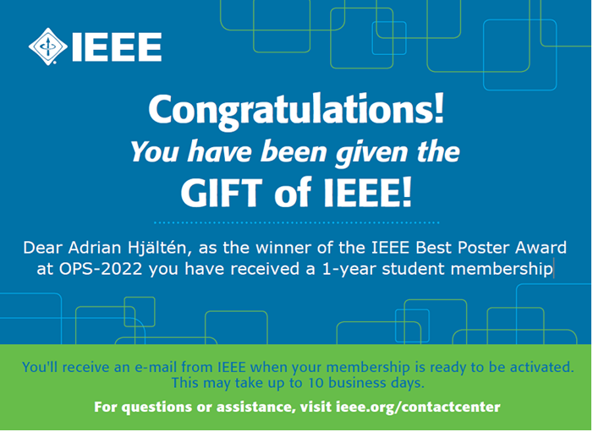
IEEE Photonics Society – Sweden Chapter
Sponsoring IEEE Student memberships
The intention is to increase the number of students being
members of our Society with the hope that they will stay as
regular members when they enter their professional career
The sponsoring of a 1-year IEEE student membership fee
will be used, e.g., as an add-on to our Best Paper/Poster
Awards
Some restrictions:
  Recipients should not be a Photonics Society student member
  The student needs to be enrolled at a Swedish university
  The student will get this gift only once
The process:
  The cost is $37.00 USD (i.e., 406 SEK) per student membership (2023)
  (IEEE membership: $27.00 USD and IEEE Photonics Society membership: $10.00 USD)
  However, it should be reimbursed retroactively

Slide 14
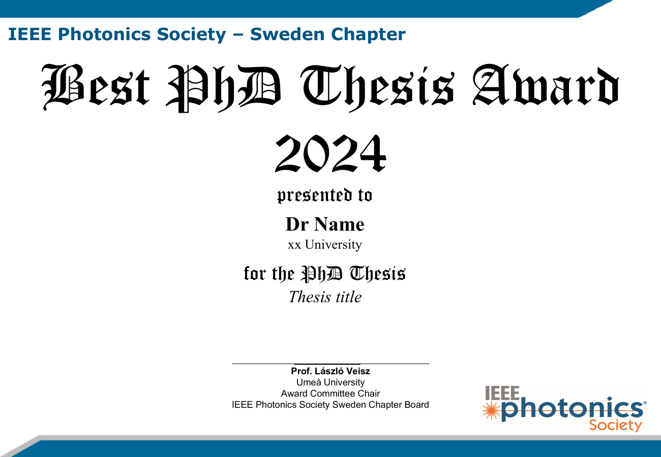
IEEE Photonics Society – Sweden Chapter
IEEE Best PhD Thesis Award 2024 (nomination)
Nov
2024
In 2017 the Sweden Chapter established an Award for recently graduated
PhD researchers that have written an outstanding doctoral thesis in the
general area of optics and photonics and that represents a remarkably
impactful contribution to their field
The thesis must be nominated by the main supervisor
Award Committee Chair:
  Prof. László Veisz, Umeå University
  The chair appoints suitable reviewers and based on the review reports,
  the Review Committee will then select the award winner
The award consists of 10,000 SEK and a diploma
The Award is funded by an IEEE Photonics Society 2024 Annual Chapter Grant
The nomina­tion period will be closed on 30-Nov-2024
Award criteria:
  Quality and quantity of the research (e.g., as estimated from bibliometric analysis and degree of contribution)
  Pedagogic quality (the depth of understanding demonstrated by the candidate and whether the thesis is accessible for the reader or not)
  Context (as the thesis work been properly situated with respect to existing knowledge and literature?)
  Quality of writing (Is there a coherent, structured story throughout the thesis?)
  Presentation-technical aspects (layout, figures, spelling, etc.)

Slide 15

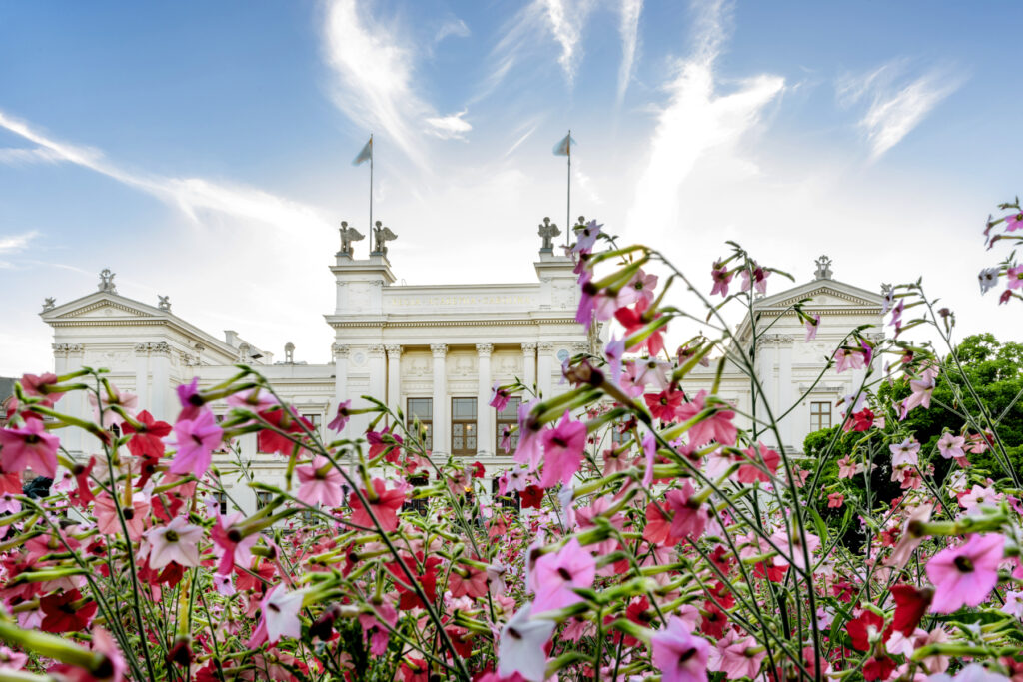
IEEE Photonics Society – Sweden Chapter
Best Poster Prize at ATTO X
July
2025
10th International Conference on Attosecond Science and Technology
Dates: 6-11 July 2025 (bi-annual international conference)
Venue: The Loop, Science Village, Lund, Sweden
Organizer: Lund University
General Chairs: Per Eng-Johnsson (Lund U.) & Anne-Lise Viotti (Lund U.)
László Veisz is a member of the Local Organizing Committee
Around 400 participants expected
Best Poster Award
  Sponsoring Best Poster Awards: 5,000 SEK
  1x Best Poster Award (3,000 SEK) and
  2x Best Poster Distinctions (1,000 SEK each)
  Eligible only for young scientists, i.e., students and post-docs
  Poster Awards Committee: László Veisz (Chair) + two others
  Apply for additional funding from the IEEE Sweden Section

Slide 16
IEEE Photonics Society – Sweden Chapter
Plans for 2025+
Continue successful activities:
  Select winner of 2024 Best PhD Thesis Award & nomination to the 2026 Best PhD Thesis Award
  Sponsoring/organizing Workshops, Seminars and Webinars on Photonics (e.g., OptoPub)
  Sponsoring/organizing Women in Photonics (WIP) events
  Sponsoring Best Poster/Paper Awards
    Conference on Attosecond Science and Technology (ATTO X)
    Optics & Photonics in Sweden (OPS-2025)
  Continue publishing an IEEE-PS-Sweden quarterly Newsletter
  Update & develop the IEEE-PS-Sweden web site
  Continue creating guidelines for yearly activities (not inventing the wheel every time)
Recruiting more members to the IPS-Sweden Board
  Possibly adding some more to diversify geographic location and technology areas
Increase the number of members (especially student members)
Improve IPS-Sweden administration
  Create a common document repository (for MoM, guidelines, templates, etc.)
Continue improving interaction with IEEE-PS-Sweden members
  Newsletters, web site, meetings, surveys, etc.
Continue interactions with other Swedish photonic organizations
  Swedish Photonics Leadership Forum (PhotonicSweden, SOS, EOS)
Investigate possibilities of joint activities
  with other Swedish Chapters: (1) IEEE Women in Engineering (WIE) Affinity Group Sweden,
  (2) IEEE MTT (microwave photonics), (3) IEEE COM (optical networks)
  Joint Nordic Chapter: Denmark, Norway, Finland, and possibly Baltic countries

Slide 17
IEEE Photonics Society – Sweden Chapter
Additional slides
Additional slides

Slide 18
History (1/4) – Major Milestones
2013 – The IEEE Photonics Society Sweden Chapter was established
  Founded by Dr. Patryk Urban
2015 – The first Board was elected
2015 – 1st Outreach event showcasing photonics to the general public
  Introduce a Girl to Photonics
2015 – 1st Women-in-Photonics (WIP) event
2016 – 1st event with an invited IEEE Distinguished Lecturer
2016 – Swedish Photonics Leadership Forum started
  A collaborative effort including PhotonicSweden, Swedish Optical Society (SOS), and
  European Optical Society (EOS) in Sweden
2016 – 1st Best Poster Award at Optical & Photonics in Sweden (OPS)
2017 – 1st Best PhD Thesis Award (in optics & photonics)
2019 – 1st IEEE-PS-Sweden Quarterly Newsletter
2019 – 1st OptoPub event (in collaboration with PhotonicSweden)
  Events to support involvement with local industry, institutes, and universities
2020 – 1st Webinar
  Events to support “professional development”
2022 – 1st Webinar with an invited IEEE Distinguished Lecturer
2022 – 1st presentation of the Chapter in the IEEE-PS Global Newsletter

Slide 19
History (2/4) – Organized/sponsored activities
Year | Organized/sponsored event | Remarks
2014 | 18th Conference on Optical Network Design and Modelling (KTH) [May] "Transformation Optics” (Chalmers) [Nov] | Technical sponsor Seminar, Co-organizer
2015 | “Frontiers and Challenges in Optical Communication” (Chalmers) [Sept] “Introduce a Girl to Photonics” (RISE) [Oct] Optics and Photonics in Sweden (OPS) (KTH & PhotonicSweden) [Oct] IEEE Nordic Congress (IEEE Section Sweden) [Nov] Women in Photonics (RISE) [Dec] | Workshop, co-organizer, financial sponsor Co-organizer, sponsor Technical sponsor, media partner Technical sponsor Co-organizer, technical/financial sponsor
2016 | Workshop on “Vertical Cavity Lasers” (Chalmers) [May] “Photonics and Electronics for School Children” (RISE) [June] Workshop on “Micro-structured Optical Fibers” (Ericsson) [Sept] OPS-2016 (LiTH & PhotonicSweden): Best Poster Award [Nov] | Co-organizer, technical/financial sponsor Co-organizer, technical sponsor Co-organizer, technical/financial sponsor Financial sponsor, media partner
2017 | Workshop on “Road to 5G and Photonics for 5G Mobile Networks” and “Women’s Leadership in Science and Technology” at ECOC-2017 [Sept] OPS-2017 (KTH & PhotonicSweden): Best Poster Award [Nov] IEEE-PS Best PhD Thesis Award 2017 [Oct] “IEEE Nordic Nano-Photonics Workshop” (Chalmers) | Organizer, technical/financial sponsor (venue was Gothenburg, Sweden) Financial sponsor, media partner Organizer, financial sponsor Co-organizer, financial sponsor

Slide 20
History (3/4) – Organized/sponsored activities
Year | Organized/sponsored event | Remarks
2018 | Workshop on “Micro-resonator Frequency Combs” (Chalmers) [April] “Women Leaders in Science and Technology”, QSIP-2018 (RISE) [June] ICAIT-2018 (KTH): Best Paper/Poster Awards [Aug] NOP-2018 (KTH, PhotonicSweden): Best Poster Award [Sept] IEEE-PS Best PhD Thesis Award 2018 [Oct] “Swedish workshop on Li-Fi technologies” (SEA, Ericsson, IEEE) [Dec] | Co-organizer, IEEE DL Co-organizer, financial support IEEE Conference TCS, financial support Award organizer, financial sponsor Organizer, financial sponsor Co-organizer
2019 | Workshop on Information Optics (WIO-2019) (KTH/RISE) [July] OptoPub in Sthlm (PhotonicSweden, IEEE) [Sept] OPS-2019 (LTH, PhotonicSweden): Best Poster Award [Oct] IEEE-PS Best PhD Theis Award 2019 [Oct] “Women in Innovation and Sustainability”, NMDC-2019 (RISE) | Co-organizer, financial support Co-organizer, financial support Award organizer, financial sponsor Organizer, financial sponsor Co-organizer, financial support
2020 | “Women-in-STEM symposium” (CSW-2020) (RISE) [Postponed] OptoPub in Sthlm (PhotonicSweden, IEEE) [Postponed] OPS-2020 (Umeå-U, PhotonicSweden): Best Poster Award [Postponed] IEEE-PS Best PhD Thesis Award 2020 [Oct] “Sensors at Antarctica”, seminar at KTH Space Center (RISE/KTH) [Nov] “Metamaterial in Photonics”, webinar (Chalmers/RISE) [Dec] | Co-organizer, financial support Co-organizer, financial support Award organizer, financial sponsor Organizer, financial sponsor Co-organizer, financial support Organizer

Slide 21
History (4/4) – Organized/sponsored activities
Year | Organized/sponsored event | Remarks
2021 | “Women-in-STEM symposium” (CSW-2021) (IEEE/RISE/KTH) [May] ONDM-2021 (Chalmers): IEEE Best Student Paper Award [June/July] OPS-2021 (Umeå-U, PhotonicSweden): Best Poster Award [Postponed] OptoPub in Sthlm (PhotonicSweden, IEEE) [Nov] Nominations for IEEE-PS Best PhD Thesis Award 2021 [Nov] | Co-organizer, financial support Award organizer, financial sponsor Award organizer, financial sponsor Co-organizing, financial support Award organizer, financial support
2022 | “Computational Nanophotonics” (IEEE DL webinar) [Feb] OPS-2022 (Umeå-U, PhotonicSweden): IEEE Best Poster Award [Oct] Nominations for IEEE-PS Best PhD Thesis Award 2022 [Nov] OptoPub in Sthlm (PhotonicSweden, IEEE) [Dec] | Organizer Award organizer, financial sponsor Award organizer, financial sponsor Co-organizing, financial support
2023 | Women-in-STEM event at PGC-2023 (IEEE/KTH) [Aug] OPS-2023 (KTH, PhotonicSweden): IEEE Best Poster Award [Oct] Nominations for IEEE-PS Best PhD Thesis Award 2023 [Nov] Celebration of Nobel Prize 2023 – WIP event [Dec] OptoPub in Sthlm (PhotonicSweden, IEEE) [Dec] (also with a celebration of the Chapter’s 10th Anniversary) | Organizer, financial sponsor Award organizer, financial sponsor Award organizer, financial sponsor Co-organizer, financial sponsor Co-organizing, financial support
2024 | OPS-2024 (KTH, PhotonicSweden): IEEE Best Poster Award [Nov] Nominations for IEEE-PS Best PhD Thesis Award 2024 [Nov] OptoPub in Sthlm (PhotonicSweden, IEEE) [Dec] [planning] | Award organizer, financial sponsor Award organizer, financial sponsor Co-organizing, financial support

Slide 22
IEEE PS Sweden – Board meeting
Contribution to IEEE-Photonics Society Newsletter
Background
  This article has been requested by IEEE Photonics Society office
  The Newsletter reaches more than 100,000 professionals
  Published in the April 2022 issue of the IEEE-PS Newsletter
Content
  General presentation of the Chapter
  Example of annual activities/awards organized by the Chapter
  The Chapter’s sponsoring of WIP events
  Events showcasing photonics to the general public
  Involvement with local industry, institutes, and universities
  (mainly collaboration with PhotonicSweden and the sponsoring of OptoPubs)
  Presenting the Chapters quarterly Newsletter
  Contribute to dissemination of technical knowledge, as well as
  professional development through continuing education,
  i.e., workshops, seminars, and webinars organized by the Chapter
  Honoring the good relationship with the staff of the IEEE Photonics Society
Maybe a one-page presentation of each Chapter would
be something for the Sweden Section Newsletter

