Slide 1
IEEE EPS Nordic Chapter activities
Assoc. Prof. Jiantong Li, KTH, Chairman
Prof. Johan Liu, Chalmers, Deputy Chairman
Emails: jiantong@kth.se ; jliu@chalmers.se

Slide 2
IEEE EPS Nordic Chapter Committee
Committee Members:
Assoc. Prof. Jiantong Li | Royal Institute of Technology, Sweden, Chair
Prof. Johan Liu | Chalmers University of Technology, Sweden, Deputy Chair
Mr. Markus Enmark | Chalmers University of Technology, Sweden, Student Chapter activity
Dr. Sen Mei | SINTEF, Norway
Dr. Toni Mattila | Invest in Finland, Finland
Dr. Gustaf Mårtensson | Mycronic AB, Sweden
Dr. Christèle Grimaud | CEVT AB, Sweden
Dr. Shuangxi Sun | Fingerprint Cards AB, Sweden
Assoc. Prof. Zhibing Zhang | Uppsala University, Sweden
Prof. Matti Mäntysalo | Tampere University, Finland

Slide 3
Activity between From Nov 2023 until now
Summary
3 Webinar/Seminars
1 Conference

Slide 4
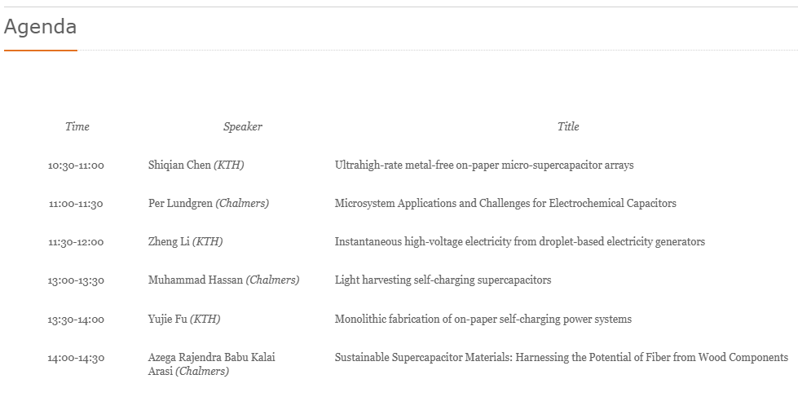
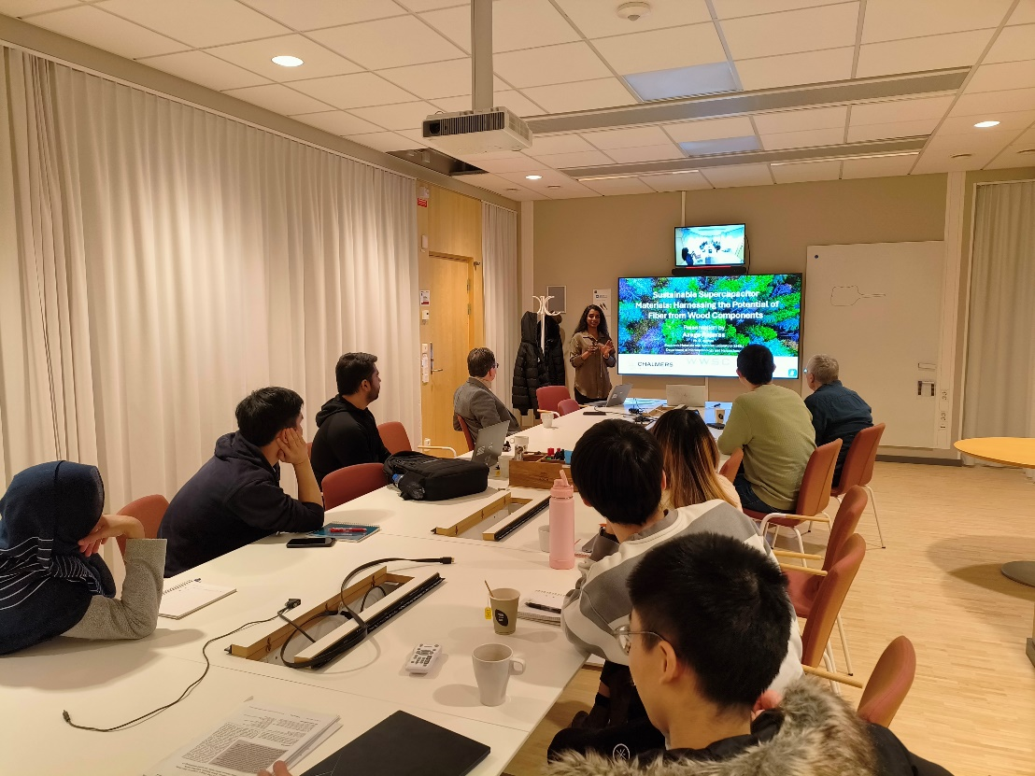
Seminar: Emerging Energy Storage and Harvesting Technologies
March 20, 2024, joint seminar between Chalmers and KTH
Location: Electrum, KTH Kista & Zoom
Number of Antendees (online & physically): 12 (including 2 IEEE members)

Slide 5
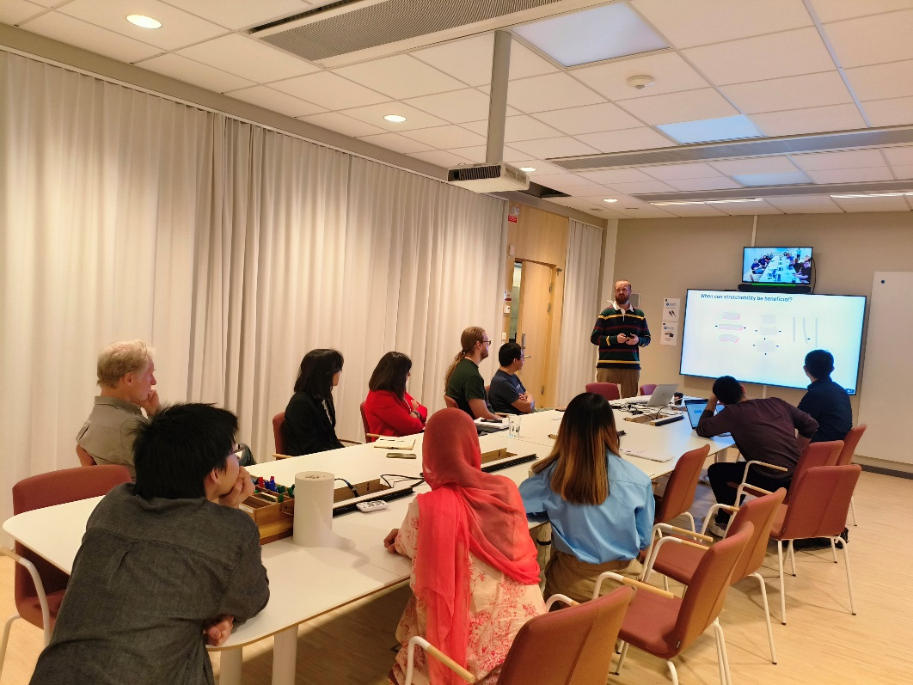
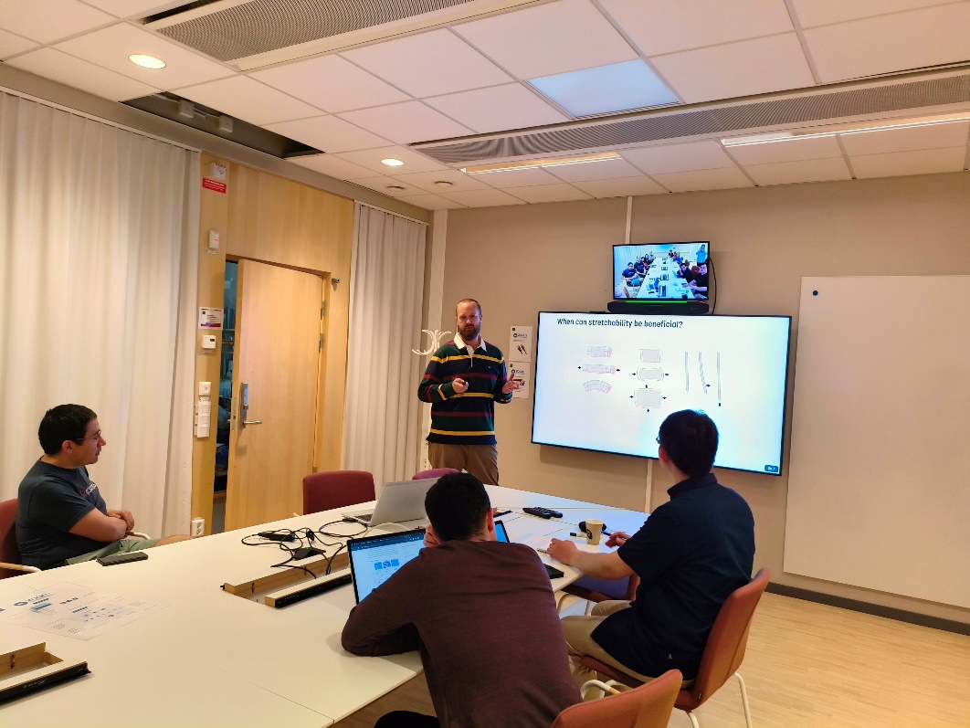
Seminar: Wearable Electronics based on Stretchable Nanocomposites
May 31, 2024, by Prof. Klas Tybrandt, Linköping University,
Location: Electrum, KTH Kista & Zoom
Number of Antendees (online & physically): 18 (including 6 IEEE members)

Slide 6
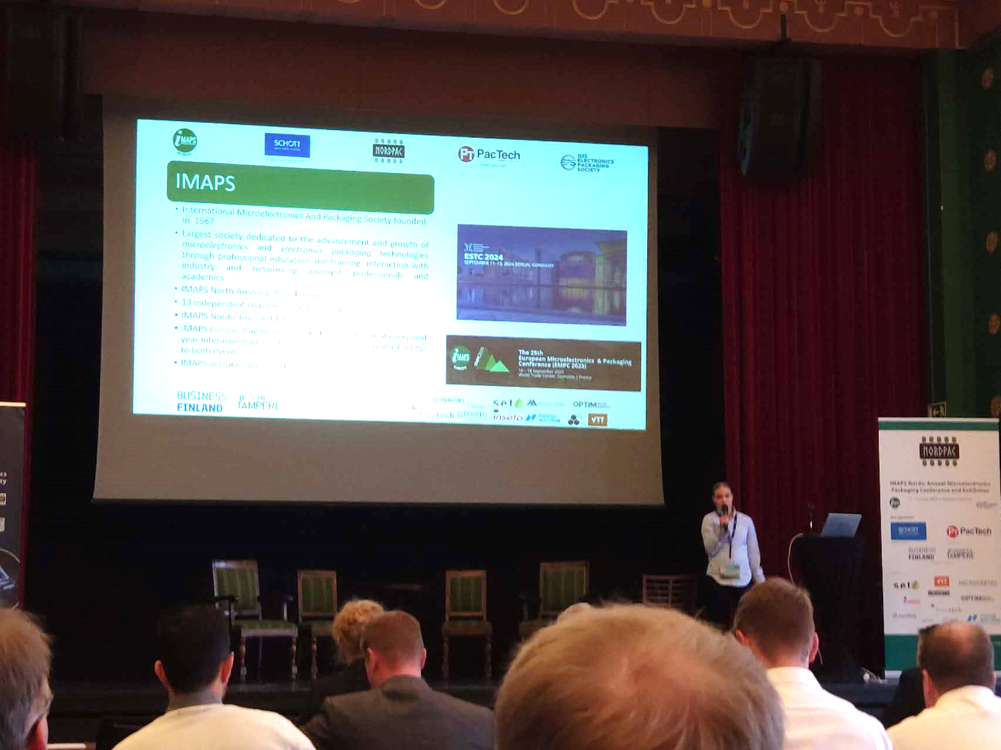
IEEE EPS Nordic Chapter and IMAPS Co-sponsored NordPac Conference June 11-13,2024, Tampere, Finland
Location: Scandic Rosendahl, Tampere, Finland
70 registered participants
4 keynotes, 2 short courses.
A great success!
Next-Gen packaging
Sustainable materials in electronics
The European Chips Act: Opportunities & Challenges
Photonics-electronics integration and co-packaging
3D Advanced Packaging
Materials and Processing

Slide 7
Webinar: Software engineering and formal methods for improved chip design productivity
Oct 2, 2024, by Dr. Edward Wang, MIT, USA
Location: Zoom
Number of Antendees:
9 (including 1
IEEE member)

