Slide 1
IEEE Sweden Section Chapter Chairs Workshop 2023
IEEE Sweden Young Professionals Affinity Group
Oksana Moryakova
PhD student, Linköping University
IEEE Sweden YP Chair
IEEE Sweden Student Activities Chair

Slide 2
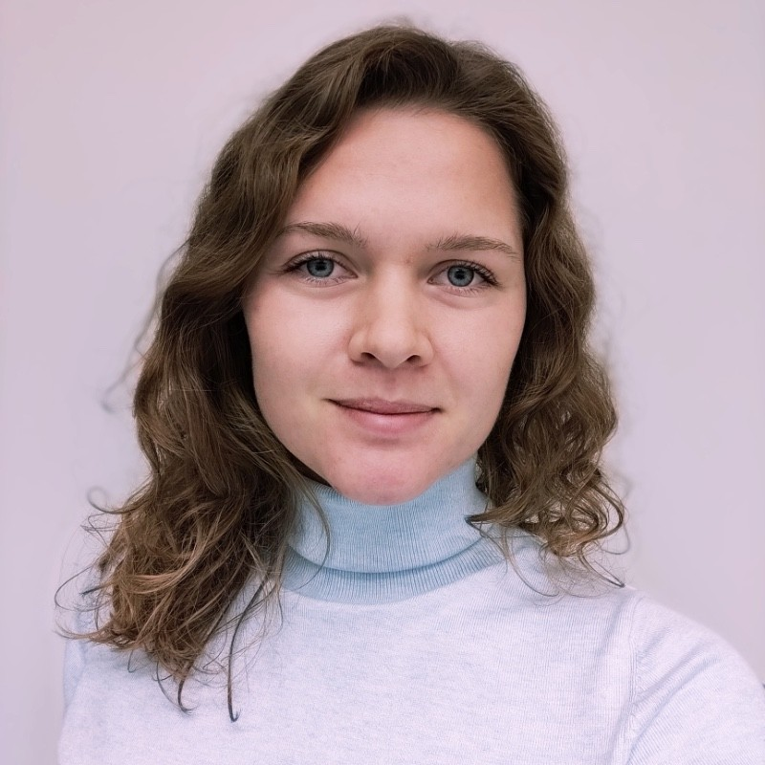
Board Members
Oksana Moryakova
PhD student, Linköping University
Suleman Khan
PhD student, Linköping University

Slide 4
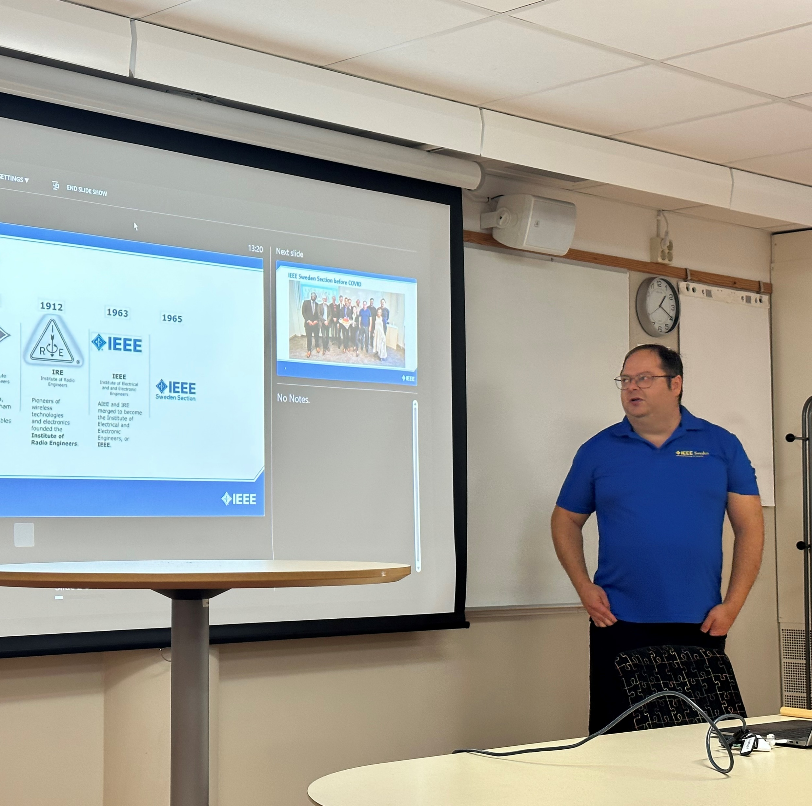
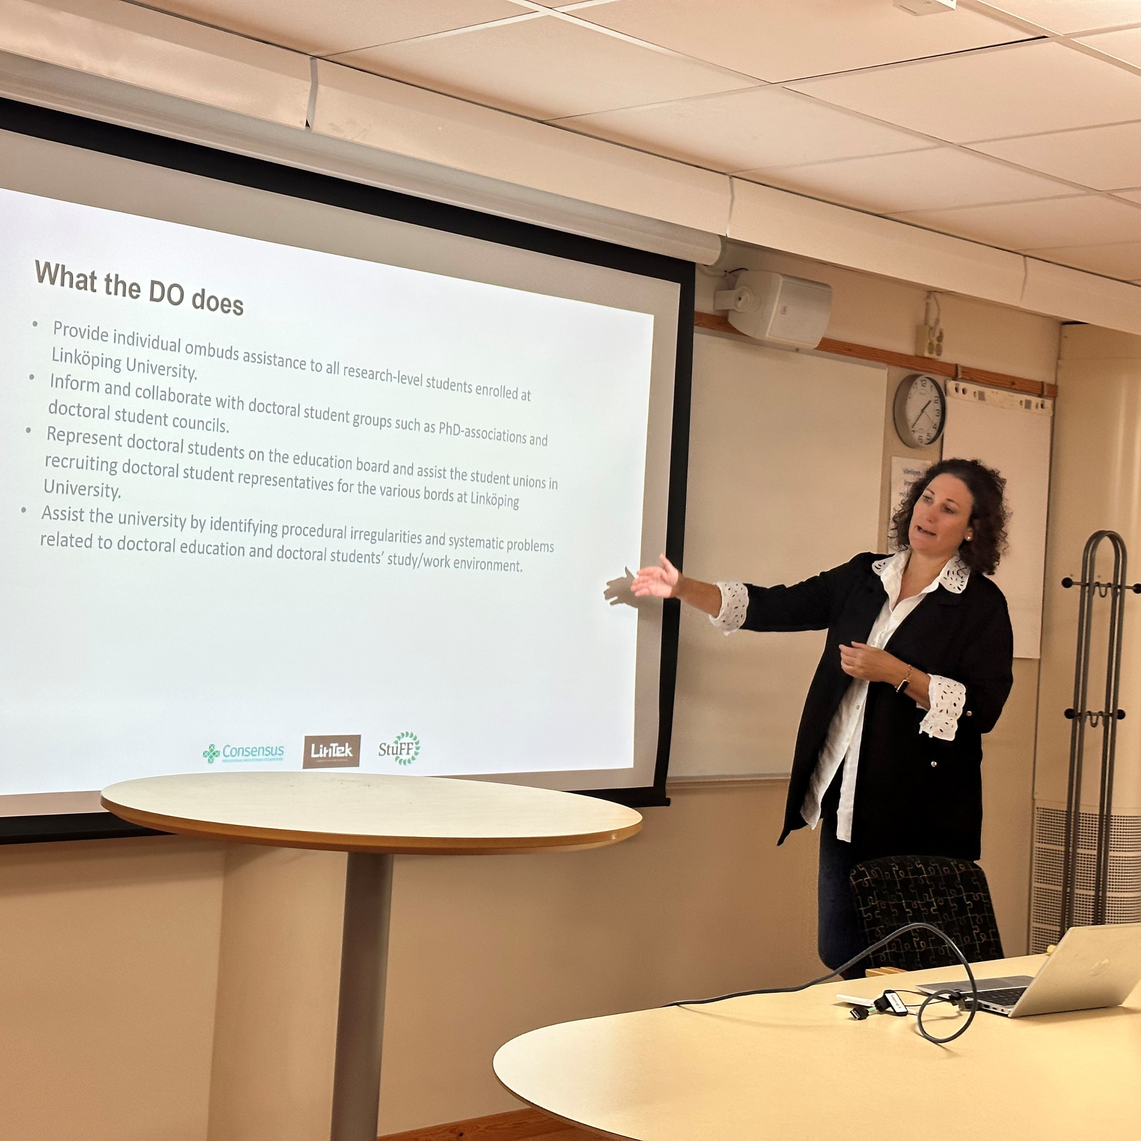
IEEE PhD Fika at Linköping University
In-person event
14 participants
Collaboration with IEEE Linköping Student branch
Used budget: 1800 SEK

Slide 5
Celebration of the 75th Anniversary of the IEEE Signal Processing Society - Young Professionals Luncheon
Hybrid event
16 participants (9 in person)
Collaboration with IEEE SPS Chapter
Used budget: 0 SEK (everything was sponsored by the SPS Chapter)

Slide 6
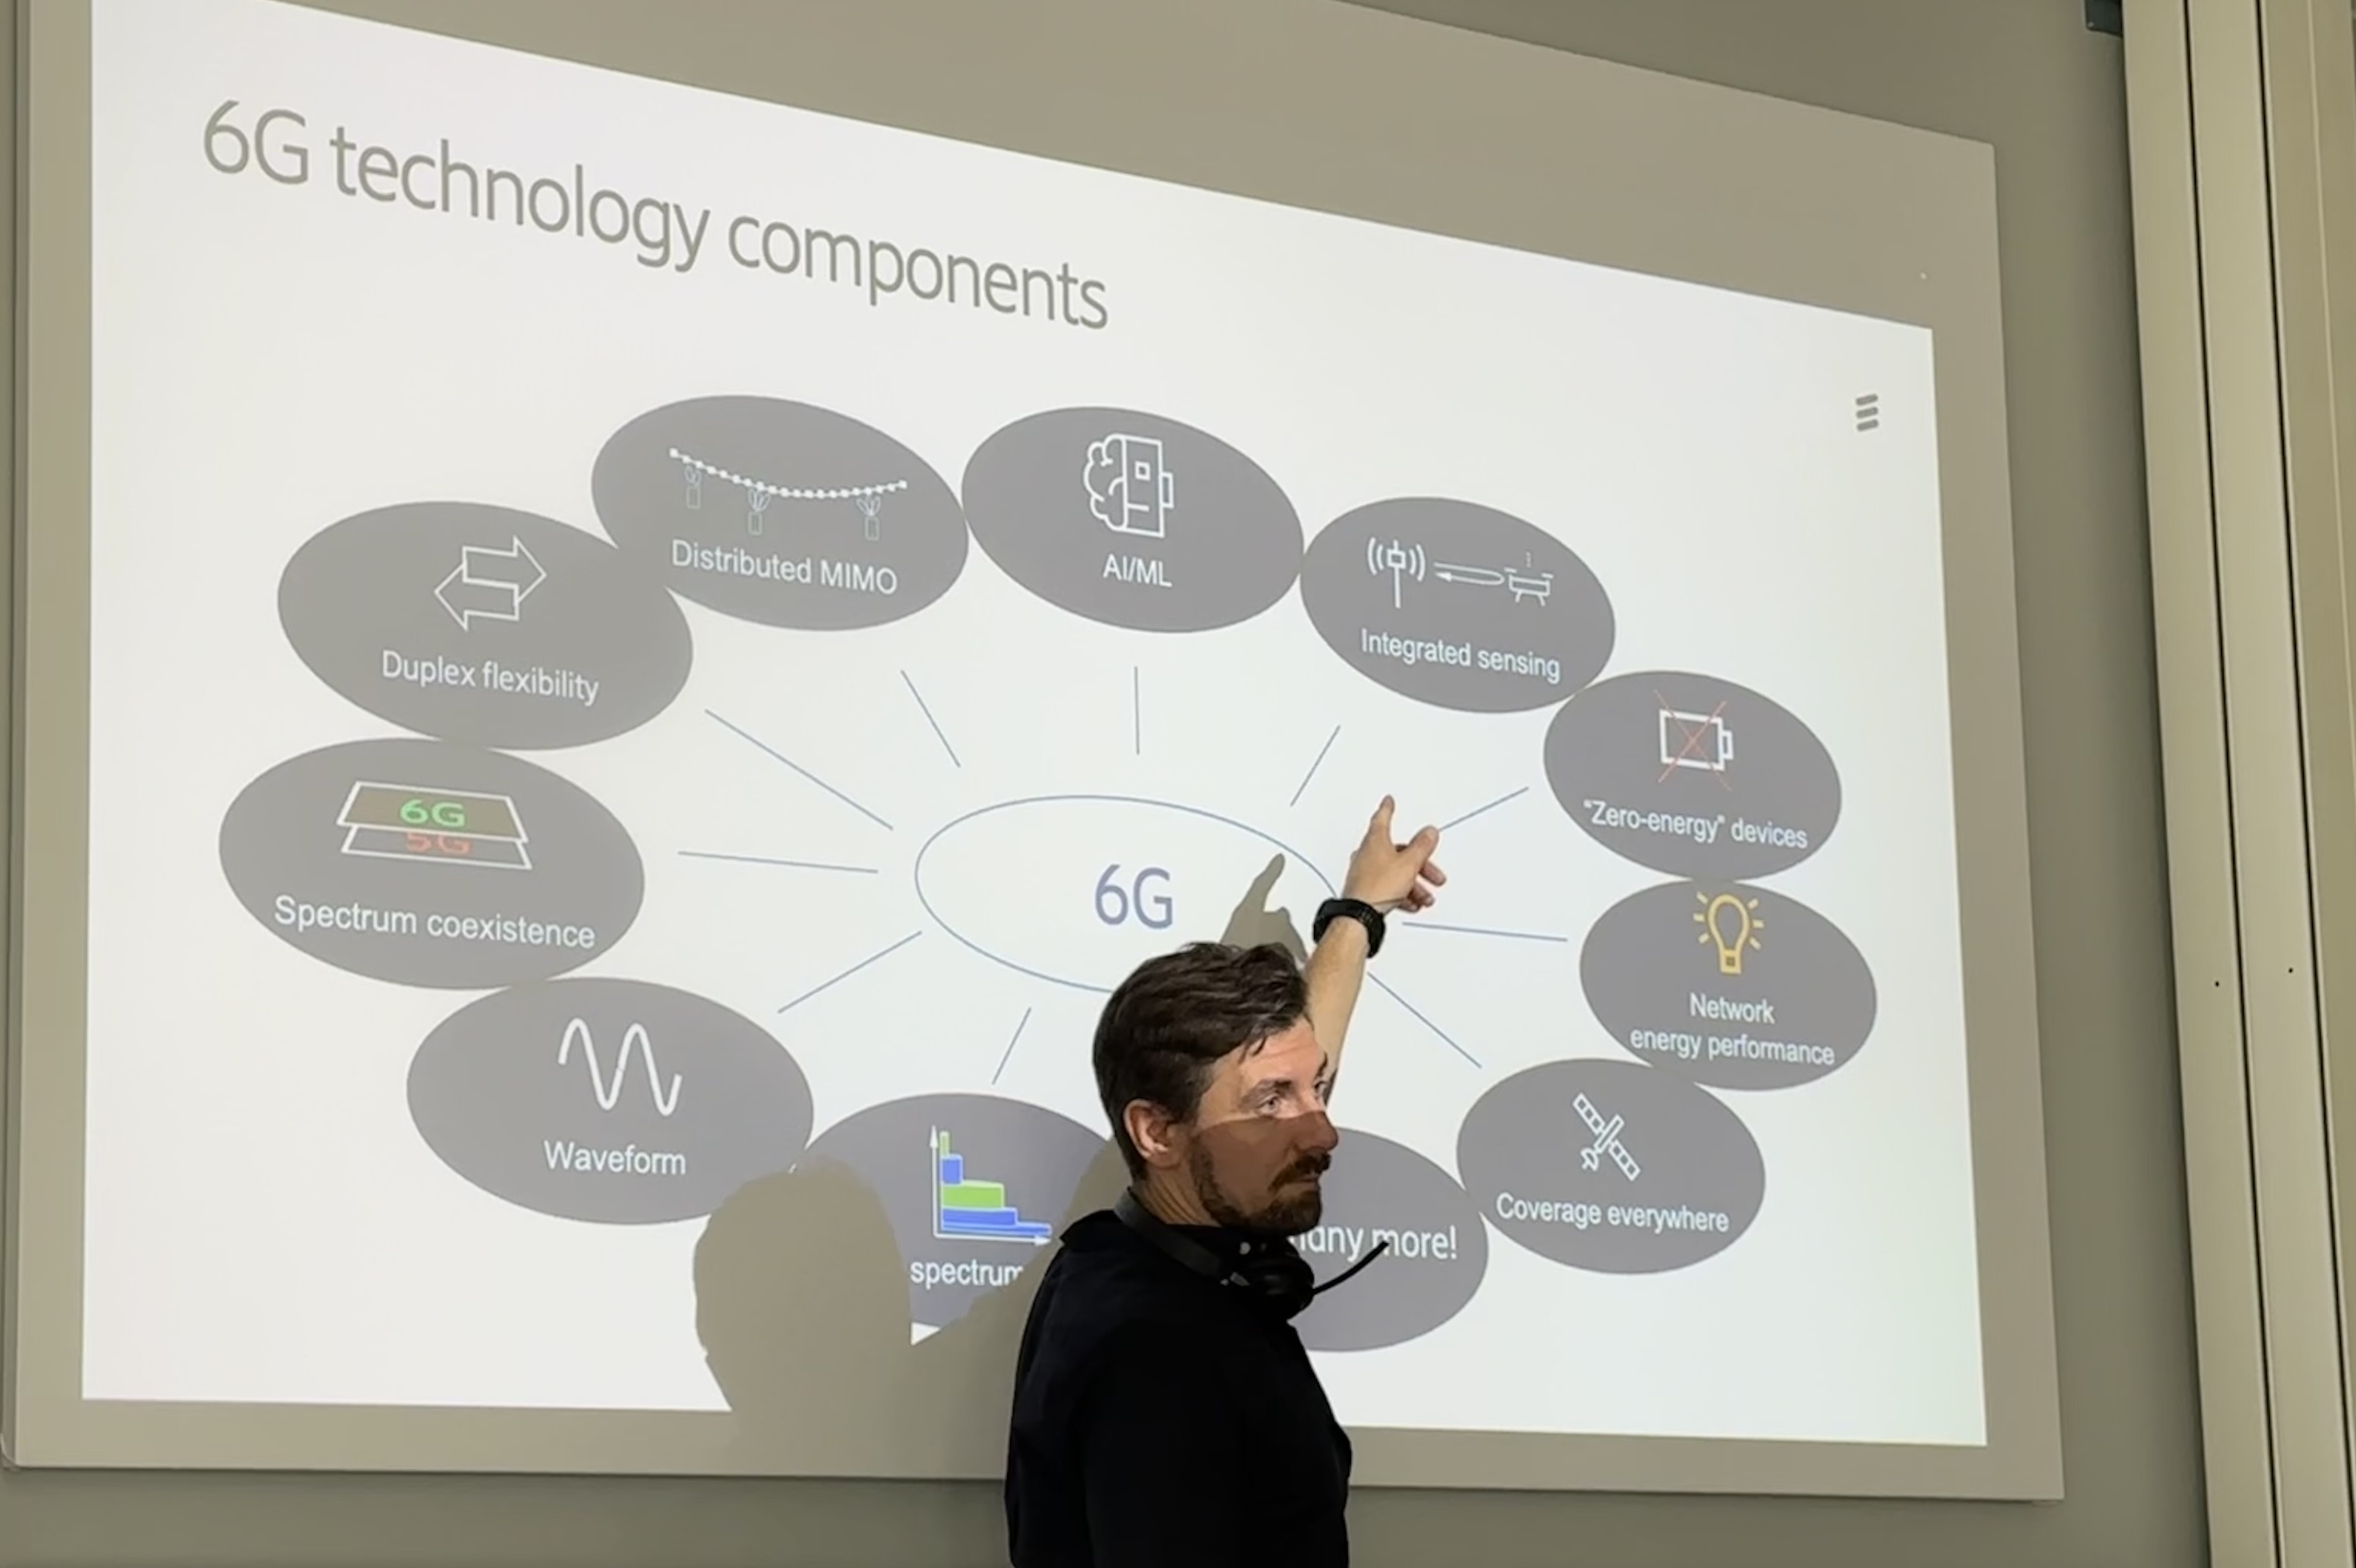
IEEE YP Distinguished Lecture
Hybrid event
21 participants (17 in person)
Collaboration with IEEE Linköping Student branch
Used budget: 0 SEK

Slide 7
This Year Budget
Allocated: 15000 SEK
Used: 1800 SEK

Slide 8
Support and Help
YP website
YP experienced officers, collaborations

