Slide 1
IEEE EPS Nordic Chapter activities
Professor: Johan Liu, Chalmers, Chairman
Associate Professor: Jiantong Li, KTH, Deputy Chairman
Email: jliu@chalmers.se; jiantong@kth.se

Slide 2
IEEE EPS Nordic Chapter Committee
Committee Members:
Prof Johan Liu | Chalmers University of Technology, Sweden, Chair
Assoc. Prof. Jiantong Li | Royal Institute of Technology, Sweden, Deputy Chair
Mr Markus Enmark | Chalmers University of Technology, Sweden, Student Chapter activity
Dr Sen Mei | SINTEF, Norway
Dr Toni Mattila | Invest in Finland, Finland
Dr Gustaf Mårtensson | Mycronic AB, Sweden
Dr Christèle Grimaud | CEVT AB, Sweden
Dr Shuangxi Sun | Fingerprint Cards AB, Sweden
Assoc. Prof. Zhibing Zhang | Uppsala University, Sweden
Prof. Matti Mäntysalo | Tampere University, Finland

Slide 3
Activity between From June 2022 until now
Summary
4 Webinar/Seminars
1 Conference

Slide 4
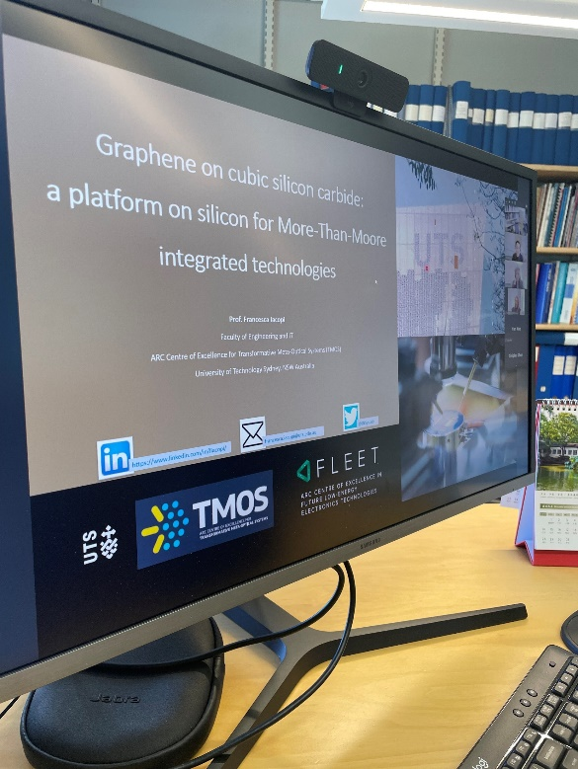
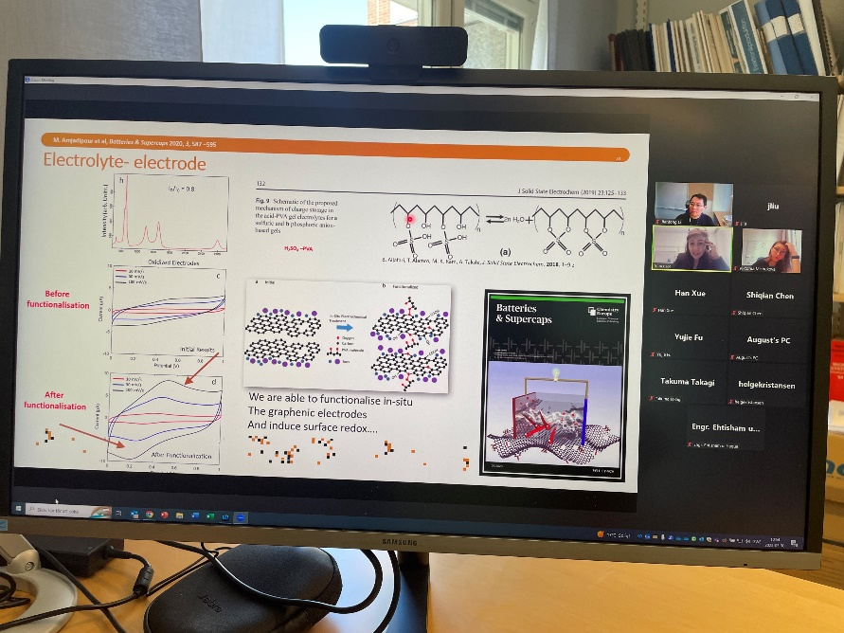
Webinar: Graphene on cubic silicon carbide: a platform on silicon for More-Than-Moore integrated technologies
May 30, 2023, by Prof. Francesca Iacopi of University of Technology Sydney, Australia
Location: Fasrummet MC2 Chalmers, & Zoom
Number of Antendees: 11 (including 5 IEEE members)

Slide 5
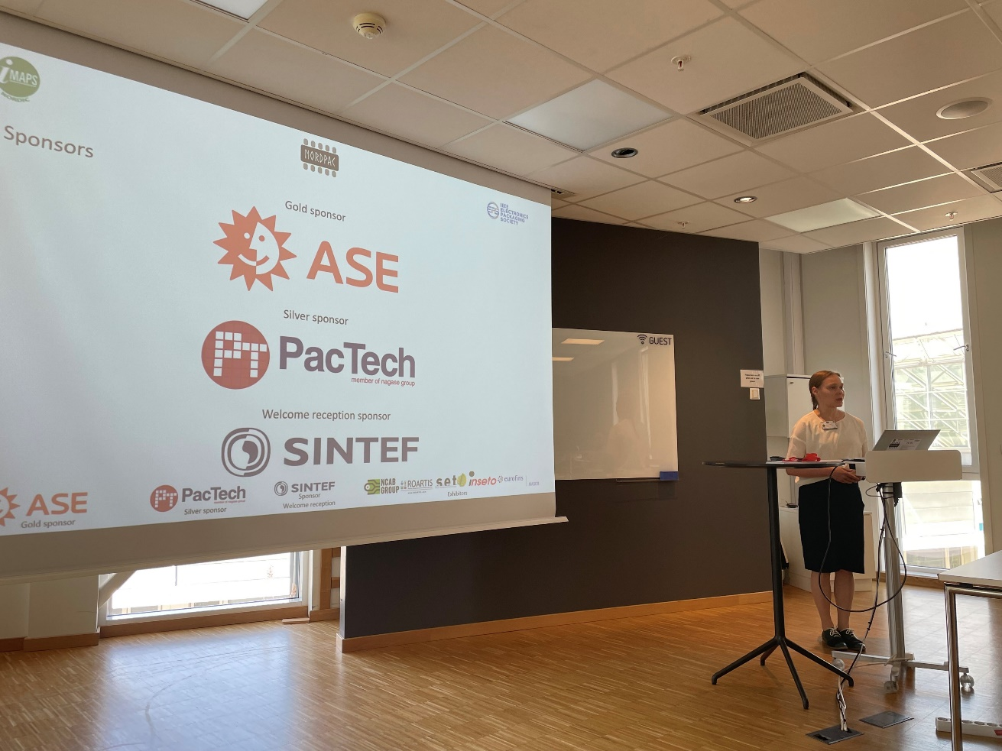
IEEE EPS Nordic Chapter and IMAPS Co-sponsored NordPac Conference June 12-14,2023, Oslo, Norway
Location: Oslo Science City, Oslo, Norway
80 registered participants
5 keynotes, 2 short courses.
A great success!
Optoelectronics Harsh environment Applications
Advanced Packaging Electronics Reliability & Quality
Materials & Processes Medical electronics
Power electronics Wearable electronics
Green Technologies Printed electronics
Advanced packaging for MEMS & sensors & sensor systems

Slide 6
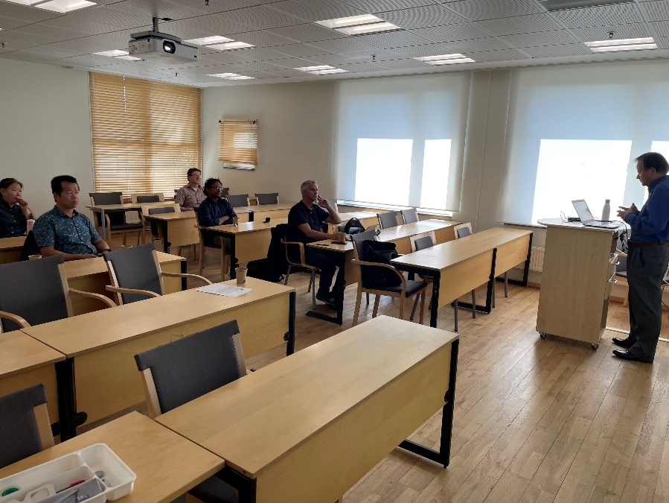
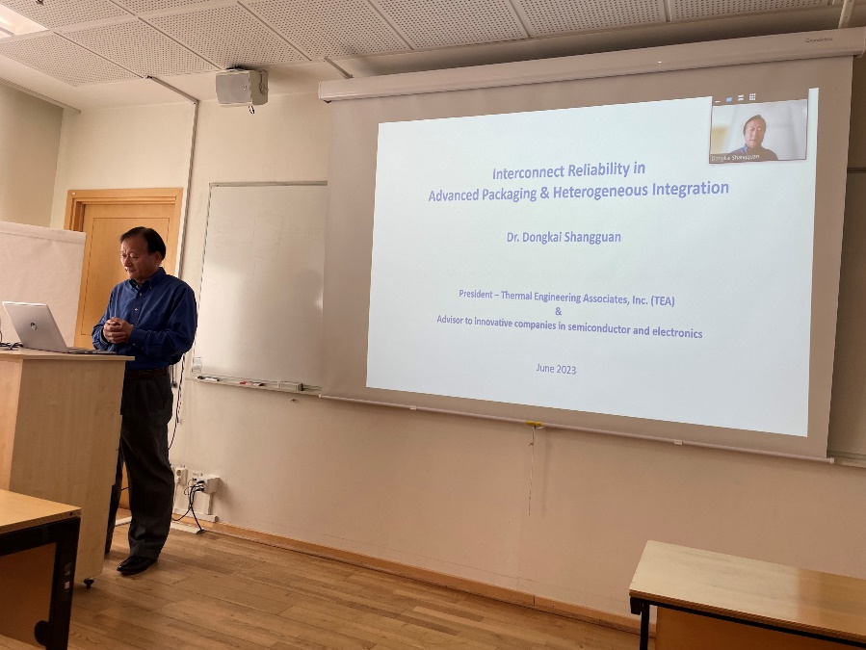
Webinar: Interconnect Reliability in Advanced Packaging & Heterogeneous Integration
June 9, 2023, by Dr. Dongkai Shangguan, IEEE Fellow
Location: Fasrummet MC2 Chalmers, & Zoom
Number of Antendees (online and physically): 27 (including 9 IEEE members)

Slide 7
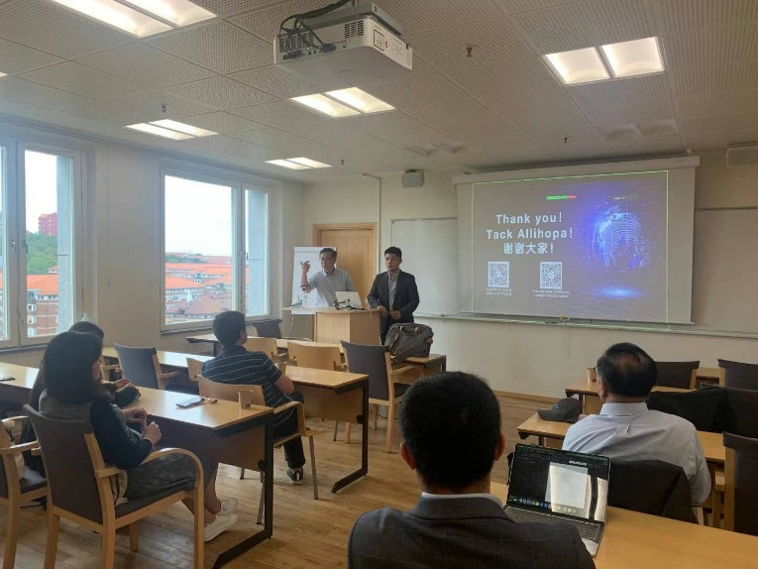
Webinar: The Chinese Graphene Decade: A Rising Industry
September 6, 2023, by Dr. Minyang Lu, Deputy Director of China-Europe Cooperation Graphene Innovation Center
Joint Seminar with VINNOVA Competence Centre 2D-TECH; Graphene Center at Chalmers (GCC) and IEEE EPS Nordic Chapter
Location: Fasrummet MC2 Chalmers, & Zoom
Number of Antendees (both online and physically): 36 (including 12 IEEE members)

Slide 8
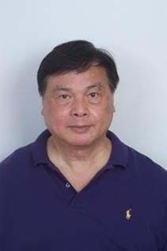
Webinar: Lateral Communications (Bridges) between Chiplets and Heterogeneous Integration Packaging
June 13, 2023, by Prof. John H Lau, IEEE fellow
IEEE EPS and IMAPS Nordic Chapter Joint Seminar in NordPac 2023
Location: Oslo Science City, Norway & Zoom
Number of Antendees: 52 (including 10 IEEE members)

Slide 9
https://imapseurope.org/event/nordpac-2024/
NordPac 2024 Tampere, Finland
Welcome!

