Slide 1
Project Management for Developing Countries
Adesoji Lawal, PMP, MNSE, MIEEE, CEH
Managing Consultant
Broadsocket Solutions Limited

Slide 2
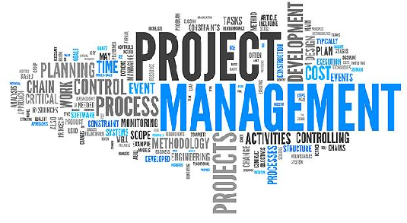
Project Management
Well Know Concepts & Definition…
Project Management: The Application of Knowledge, Skills, Tools, Techniques to Project Activities to Meet Project Requirements
Is a “Planning Game”……MANAGEMENT PLANS
Integrated | Scope | Time | Cost | Quality | Human Resource | Communication | Risks | Procurement | Stakeholder
Other Skill Set
Leadership & Coaching
Team building & Motivation
Communication
Influencing
Decision Making
Political & Cultural Awareness
Negotiation
Conflict Management

Slide 3
Project Management
Golden Rules….the 12 Commandments
Thou Shalt Gain Consensus On Project Outcome.
Thou Shalt Build The Best Team Possible.
Thou Shalt Develop A Comprehensive, Viable Plan And Keep It Up-to-date.
Thou Shalt Determine How Much Stuff You Really Need To Get Things Done.
Thou Shalt Have A Realistic Schedule.
Thou Won’t Try To Do More Than Can Be Done
Thou Will Remember That People Count
Thou Will Gain The Formal And Ongoing Support Of Management And Stakeholders.
Thou Must Be Willing To Change
Thou Must Keep Others Informed Of What You’re Up To.
Thou Must Be Willing To Try New Things.
Thou Must Become A Leader

Slide 4
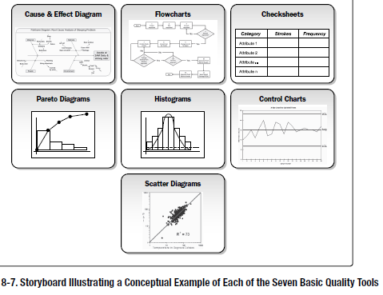
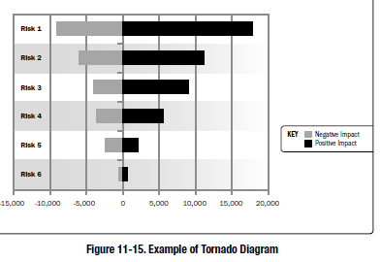
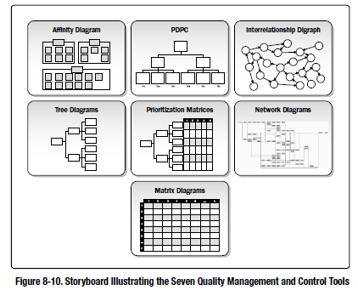
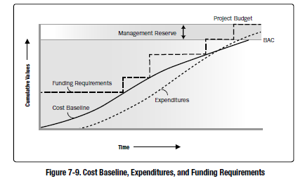
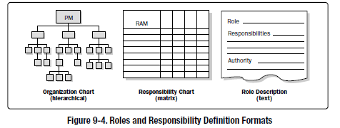
Project Management
Project Management Tools & Techniques

Slide 5
Project Management
Weak Economy
Project Management
Corruption
Poor Infrastructure
Talent Gap
What is Peculiar About Developing Countries
Local Context
What is Peculiar About Developing Countries
Poor Infrastructures
Poor Institutions
Corruption
Talent Gap
etc.

Slide 6
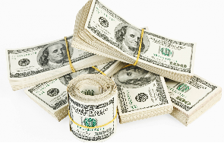
Project Management
What is Peculiar About Developing Countries
Huge Infrastructure Gap Means We Need Huge Funds
According to McKinsey & Co., an estimated US$57 trillion will be needed to finance infrastructure development around the world through 2030, with much of that investment needed in developing countries….
Public-private partnership projects can help emerging economies fill infrastructure gaps—if governments define a clear ROI.
Built Operate Transfer (BOT), Minimum Revenue Guarantee (MRG), Annuity Structure etc.

Slide 7
Project Management
What is Peculiar About Developing Countries
Uncertainty & Risk is High in Developing Economies
Uncertainty characterizes situations where the actual outcome of a particular event or activity is likely to deviate from the estimate or forecast value.
A frequently used strategy to reduce uncertainty has been to
Increase the input of resources,
To broaden the scope of the projects in an attempt to include and
Manage as many of the uncertainty factors as possible,
Use expatriate personnel in key positions.
“One of the many uses of risk analysis is in distinguishing between bad luck and bad management” (R. Raftery)
Risk
Risk
Customer
Expectation
Business
Objectives

Slide 8
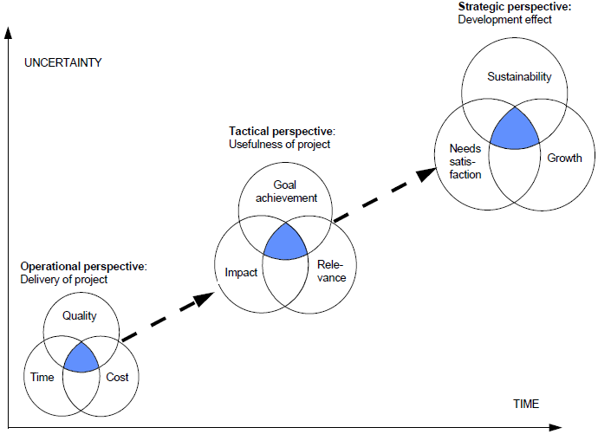
Project Management
Success Indicators
Efficiency (The Delivery Of The Project In Terms Of Cost, Timing And Quality)
Effectiveness (The Extent To Which The Project Goal Has Been Achieved)
Impact (The Sum Of Positive And Negative, Planned And Unforeseen Changes\ And Effects Of The Project In Society)
Relevance (The Degree To Which The Project Respond To Real Needs And Priorities In Society)
Sustainability (The Extent To Which The Positive Effects Of The Project Will Continue In The Future).

Slide 9
Project Management
Pragmatic Approach
Adopt Project Management Best Practice ..and Add a Few of Our Own as well
Engage Technology to Drive Project Transparency and Stamp-out Corruption…Digital Project management, Digital Procurement
Harness Our Cultural Values for Higher Productivity and Effectiveness
Share Our Experience….Contribute to Global Project Management Standard and Practice Code
Keep Doing…Keep Getting Better…Keep Improving

Slide 10
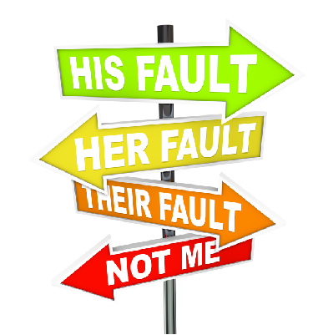
Project Management
Pragmatic Approach
Accountability on High
Ultimate accountability landing on sponsors and executives….. It puts responsibility on the top people, making them answer for mistakes made
Accountability as a motivator
Leadership Without Excuses
Account for its activities
Accept responsibility for them
Disclose results in a transparent manner

Slide 11
Project Management
Pragmatic Approach
The Sustainability Balancing Act
Incorporating Sustainability Into Our Projects.
Government and Organizations should be able to tie a number of project together to achieve a Higher Strategic Goal
Think Long Term

Slide 12
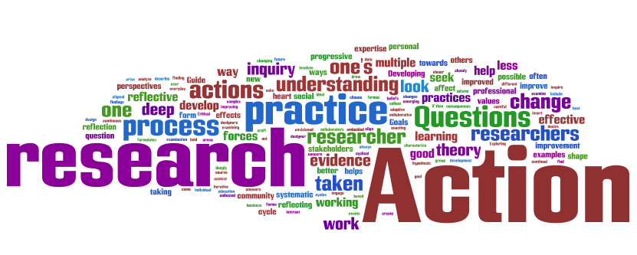
Project Management
Pragmatic Approach
Educate to Innovate
Actively investing in Human Capital, including a new generation of Project Management Leaders.
More Institutions of Learning Should Take on Project Management…Secondary and Tertiary
More Research and Studies To Carve Out Project Management Best Practices

Slide 13
Project Management
Pragmatic Approach
In Conclusion:
How much up-front planning should we do? How many people should we hire? How many meetings, documents and procedures do we need?
Just Enough. Only do enough preperation or support work to achieve the primary goal of delivering value.
Just in Time. You could be crafting lightweight documents, lightweight architecture and lightweight processes—and still be doing all that lightweight work way too prematurely
Just Because. This is the constraint that keeps us grounded in reality. I know the 40-page template violates “just enough documentation,” but we’re going to use it, just because we won’t get sign-off without it

Slide 14
Project Management
Thank You
Questions?

