Slide 1
Italy Chapter of the IEEE Sensors Council: purpose and potential collaboration
Emiliano Schena
Napoli 20/06/2018

Slide 2
Sommario
Introduzione al chapter italiano dell’IEEE Sensors Council
Organizzazione del Chapter
Attività del Chapter

Slide 3
Definizione e attività di un chapter
Definizione
Sotto-unità di una o più IEEE Sections, costituite da membri di una o più IEEE Societies che condividono interessi e prossimità geografica
Attività
guest speakers, Workshops, seminari,..
Fondazione
Tramite petizione

Slide 4
IEEE Sensors Council
IEEE Sensors Council
Fondato nel 1998 da 14 societies firmatarie
Affiliato a 26 societies con >260000 membership
Obiettivi:
“.. to serve the sensor community with new publications, conferences, and technical committees. Its fields of interest and activities are the theory, design, fabrication, manufacturing, and application of devices for sensing and transducing physical, chemical, and biological phenomena, with emphasis on the electronics and physics aspects of sensors and integrated sensor-actuators..”

Slide 5
Regioni dell’IEEE
R1-6 IEEE-USA
R7 Canada
R8 Af, Eu, ME
R9 Latin America
R10 Asia, Pacific

Slide 6
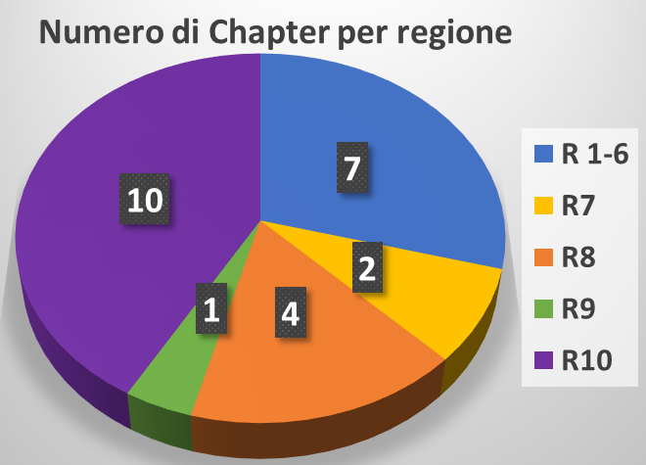
Chapters dell’IEEE Sensors Council
16 Chapters
5 Joint Chapters
3 Student Branch Chapters
Spagna
(2013)
UK e Irlanda
(2015)
Italia
(2018)
Francia
(2018)

Slide 7
Italy Chapter IEEE Sensors Council
Spagna
(2013)
UK e Irlanda
(2015)
Italia
(2018)
Petizione
Business plan
Raccolta firme tra i membri
Endorsement
T. Tambosso
(Chair IEEE Sec Ita)
2 approvals
F. Labeau
(Council President)
M. Erikssen
(Op Com Director)
Francia
(2018)
Fondatori
Emiliano Schena (chair)
Calogero Oddo (vice chair)
Danilo Pani (treasurer)
Paola Saccomandi (secretary)

Slide 8
Italy Chapter IEEE Sensors Council
Spagna
(2013)
UK e Irlanda
(2015)
Italia
(2018)
Petizione
Business plan
Raccolta firme tra i membri
Endorsement
T. Tambosso
(Chair IEEE Sec Ita)
2 approvals
F. Labeau
(Council President)
M. Erikssen
(Op Com Director)
Francia
(2018)
Fondatori
Emiliano Schena (chair)
Calogero Oddo (vice chair)
Danilo Pani (treasurer)
Paola Saccomandi (secretary)

Slide 9
Italy Chapter IEEE Sensors Council
Business Plan
What was the motivating factor that led to forming this geographic unit? What member needs will be fulfilled as a result of forming this unit?
List the activities the unit will focus on for the first six months. What activities will engage the members of the unit with one another?
What accomplishments will this unit strive to meet in its first year?
What level of local support is engaged in support of the unit activities?
Notes:
Business Plan
1. What was the motivating factor that led to forming this geographic unit? What member needs will be fulfilled as a result of forming this unit? There is a fruitful activity of Italian researchers in several fields related to sensors. This activity is fragmented due to different technologies used for sensors development, different approaches for estimating the same type of measurand, different applications in which the sensor plays a crucial role. This geographic unit aims at aggregating this fragmented scenario to establish a dynamic network involving people interested in sensors field, to consolidate collaborations among researchers from academia and industry, to form a rich environment to exchange new knowledge and ideas, to foster cross-fertilization among different application domains, and to develop a fertile environment for young professionals and students working in this field. Chapter’s activities will be devoted, but not limited, to the following topics: ✓ Physical, chemical, optical sensors, biosensors, micro- and nano-sensors ✓ Sensor networks and communication ✓ Signal conditioning and processing, signal analysis, information fusion and compression ✓ Translation of novel sensor technologies from research to industry and applications of sensors in industry, with specific reference to their role in Industry 4.0, in life science, in clinical domains, in aerospace, in agriculture, in robotics, and in structure monitoring, just to mention a few interconnected areas
2. List the activities the unit will focus on for the first six months. What activities will engage the members of the unit with one another?The organizer, the co-organizers and the founding members will define an executive committee, consisting of four members (chair, vice-chair, secretary, treasurer). Chapter members potentially available for serving in these positions are the organizer (Emiliano Schena) and the co-organizers (Calogero Oddo, Danilo Pani and Paola Saccomandi) of the Chapter foundation. The organizers and the founding members will engage to disseminate the opening of the Chapter and its activities. Specifically, a web site dedicated to the Chapter will be created within two months from its approval, and updated along with activities going on. Social media, newsletters and other IEEE symposia attended by the members will be considered to share information and update about the Chapter. The organizers will define the activity plan to be proposed to the other members for approval, with special care on the strategic objectives including dissemination opportunities in IEEE flagship conferences and educational events. In the first six months, high profile guest speakers will be invited to organize two distinguished lectures. The guest speakers will be selected among top scientists in the area of the Chapter. The talks will be the occasion to discuss advances in sensors research field and their applications.
3. What accomplishments will this unit strive to meet in its first year?The main accomplishments of the first year of the Chapter will be: ✓ The executive committee shall officially take office ✓ A dedicated website showing the main activity of the chapter will be launched ✓ Dedicated social media and newsletter to share the main activities of the chapter will be active ✓ 50+ chapter members ✓ The responsible of communication and dissemination on social media will be identified ✓ Start mapping all pertinent stakeholders, e.g., from academia, research centers, industry, professional orders, policy makers and other scientific societies, and possibly establish synergies ✓ Distinguished lecturers will nurture an environment for sharing ideas and knowledge regarding the main fields related to sensors and applications. In addition, they will contribute to consolidate the network between the region Members involved in this Chapter belonging to academia and industry, as well as to increase the number of the Chapter members among professionals and students ✓ The members of the Chapter will contribute to plan the activities of the second year considering the hypothesis of organizing a workshop and/or a conference associated to this Chapter, a summer school, as well as a meeting at Italian level to share interests regarding sensors technology, signal communication and analysis, sensors applications. The summer school will provide an important contribution to increase the students member of the Chapter ✓ The executive committee will submit the due reports of Meeting Activities.
4. What level of local support is engaged in support of the unit activities?The following three institutions: a) Università Campus Bio-Medico di Roma (reference Emiliano Schena) b) Istituto di Biorobotica, Scuola Superiore Sant’Anna di Pisa (reference Calogero Maria Oddo) c) Università di Cagliari, Cagliari, Italy (reference Danilo Pani) can provide meeting rooms and spaces for meetings. Additional meeting spaces as conference rooms and boardrooms can be make available for workshops subject to authorization of the institutional head. The forth institution, the Politecnico di Milano, will be the new host institution of the ERC starting grant project of one of the potential co-organizers (Paola Saccomandi) of the Chapter. Also there, meeting spaces and conference rooms will be make available for workshops and meetings subject to authorization of the institutional head. Pertinent initiatives proposed by any other member of the Chapter will be encouraged and supported as appropriate.

Slide 10
Italy Chapter IEEE Sensors Council
Spagna
(2013)
UK e Irlanda
(2015)
Italia
(2018)
Petizione
Business plan
Raccolta firme tra i membri
Endorsement
T. Tambosso
(Chair IEEE Sec Ita)
2 approvals
F. Labeau
(Council President)
M. Erikssen
(Op Com Director)
Francia
(2018)
Fondatori
Emiliano Schena (chair)
Calogero Oddo (vice chair)
Danilo Pani (treasurer)
Paola Saccomandi (secretary)

Slide 11
Italy Chapter IEEE Sensors Council
Spagna
(2013)
UK e Irlanda
(2015)
Italia
(2018)
Petizione
Business plan
Raccolta firme tra i membri
Endorsement
T. Tambosso
(Chair IEEE Sec Ita)
2 approvals
F. Labeau
(Council President)
M. Erikssen
(Op Com Director)
Francia
(2018)
Fondatori
Emiliano Schena (chair)
Calogero Oddo (vice chair)
Danilo Pani (treasurer)
Paola Saccomandi (secretary)

Slide 12
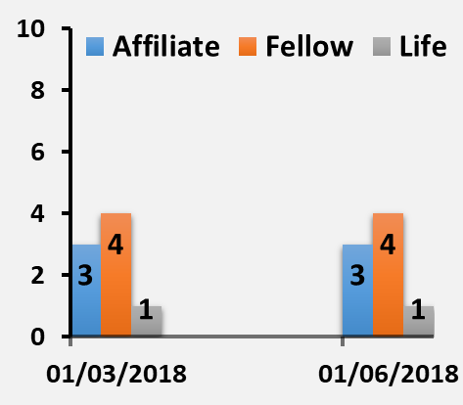
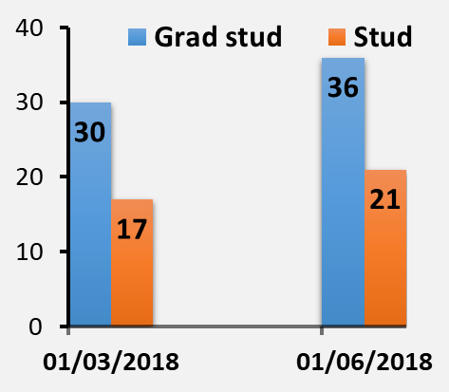
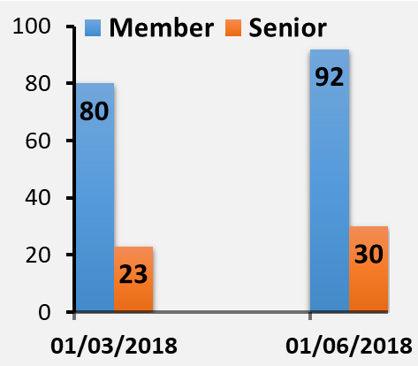
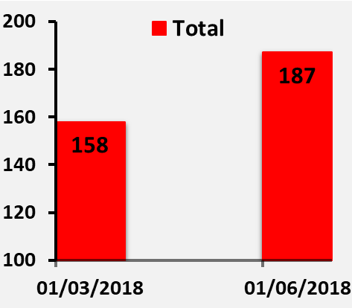
Statistiche del Chapter
Statistiche (29/5/2018)
21 Student
36 Graduate student
3 Affiliate
92 member
30 Senior
4 fellow
1 life fellow
Totale 187

Slide 13
Organizzazione del Chapter
Chapter ExCo
IEEE Italy Section
Commissioni
Servizi
(gestione sito web, …)

Slide 14
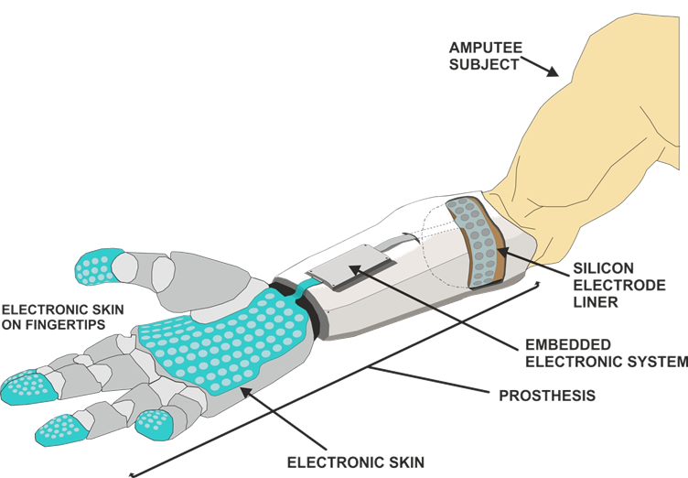
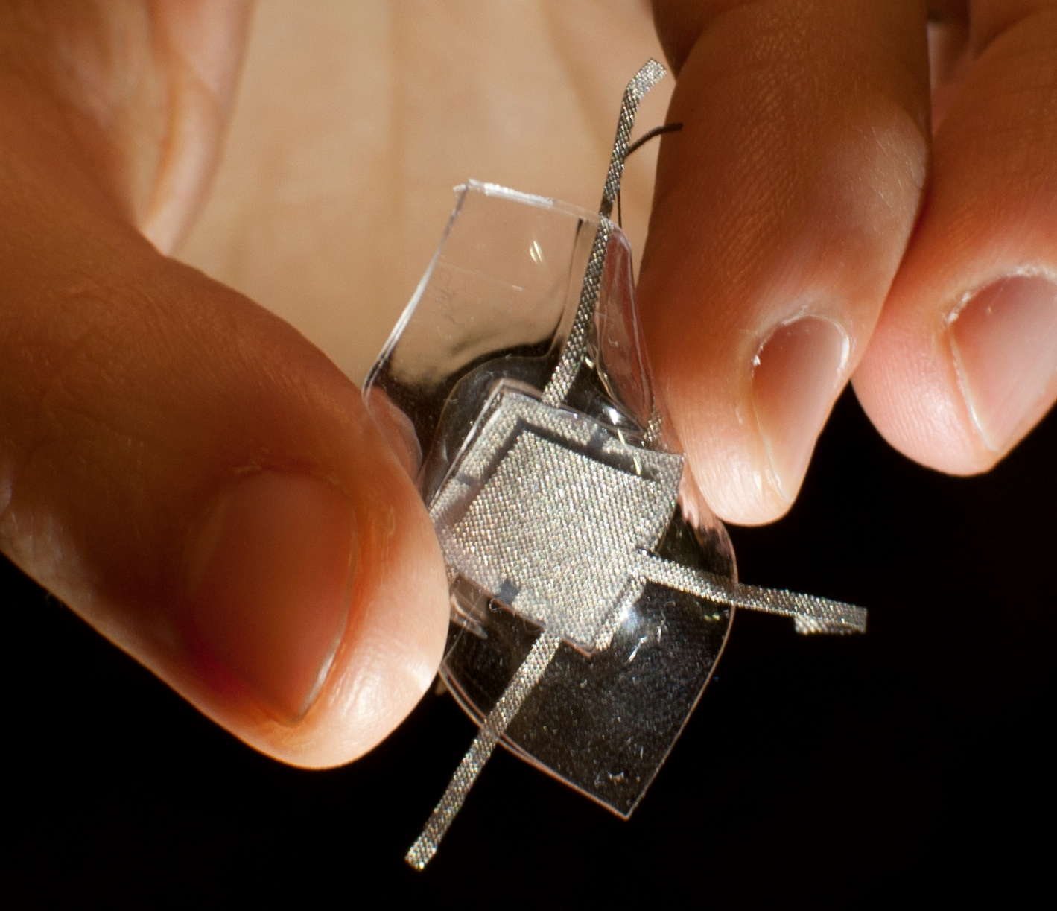
Tassonomia del Chapter
Technology
Application
Measurand

Slide 15
Commissioni attivate
Wearable sensors
Ultrasound sensors
Soft sensors
Textile sensors
Physiological sensors
Biosensors
Nanosensors
Fiber optic sensors
Sensors for biomechanics
Tactile sensors
Vibration and acoustic sensors
Sensing systems
Smart sensors & edge computing
Chemical sensors development and applications
Inertial Measurement Unit
Electronic Interfaces and Signal Processing for Sensors

Slide 16
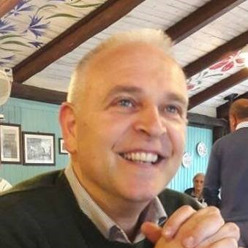
Commissioni attivate
Electronics for sensors
SCOPE
…This technical commission will take in deep consideration innovation aspects of the electronic interfaces as well as new ideas, even expressed at theoretical level, of detection-interface paradigms. Other scopes are: dissemination of the latest news on the research topics of ELECTRONICS FOR SENSORS, improving the dialogue and promote cohesion and collaboration among research groups as well as the organization of technical events, evaluation of award candidates and activation of a fruitful interaction with the industrial world…
Chair
Giuseppe Ferri was born in L’Aquila, Italy. He received the “Laurea” degree (cum laude) in electronic engineering in 1988. In 1991, he joined the Department of Electronic Engineering, University of L’Aquila, L’Aquila, Italy, where he is actually a full professor of Electronics and Microelectronics. His research activity mainly concerns the design of analogue electronic circuits for sensor and biomedical applications both in voltage and in current mode…

Slide 17
Attività delle commissioni: esempi
Mantenere un database di nomi, sedi e contatti della comunità di riferimento in ambito accademico, enti di ricerca e industriale
Proporre e valutare candidature per Award attivati dal Chapter
Organizzazione di attività ed eventi
Essere un punto di riferimento nell’ambito delle attività di definizione di standard tecnici internazionali (link con IEEE Standards Association)

Slide 18
Attività previste nel primo anno
Assemblea fondativa
Riunione periodiche EXCo (mensile) e responsabili commissioni (trimestrale)
Avvio e aggiornamento periodico sito web
Newsletter
Invito Distinguished Lecturers
Riunione con rappresentanti dell’industria per consultazioni sugli standard di interesse nazionale
Organizzazione e partecipazione del Chapter ad eventi relative ai diversi settori di interesse (scuole internazionali e conferenze)

Slide 19
Attività svolte e attività organizzate
Distinguished Lectures/Lecture (7)
V. Lumelsky “Whole-body sensing in robotic systems operating in an unstructured environment”
V. Lumelsky “Human-Robot Interaction and Human-Robot Teams”
D. Stratos “Nuclear Medicine Instrumentation: SPECT and PET technologies”
M. Nikl “Inorganic scintillation materials: R&D state-of-art and trends”
K. Taesung “Development of Optical Fiber Sensors for Various Applications”
D. Tosi “Fiber optic sensors for real-time medical diagnostic and treatments: towards new multiplexing and spatial resolution limits”
A.P. Silvatti “Breathing biomechanics: optical measurement systems for thoracoabdominal analysis”
International summer school (3)
2-7/07/2018, Pula. “Technologies and signal processing in perinatal medicine”
23-27/07/2018, Bressanone. “Summer School of Information Engineering (SSIE)”
17-21/09/2018, Alghero. “CPS Summer School 2018: Designing Cyber-Physical Systems – From concepts to implementation”

Slide 20
Attività svolte e attività organizzate
International Conference/Workshop (3)
11-13/06/2018, Roma. 2018 IEEE International Symposium on medical measurements & applications (MeMeA).
18/06/2018, Torino. Laser-enabled mini-invasive treatments of tumors: from thermal ablation to photo-dynamics therapies
8-10/10/2018, Bari. 2018 IEEE International Workshop on metrology for the Sea
Riunione officers (2)
6/02/2018. Pianificazione attività assemblea
13/06/2018. Pianificazione attività assemblea
Assemblea fondativa (1)
16/02/2018. (presentazione chapter, votazione..)
Riunione Ex Co (3)
6/04/2018. Riunione tra tutti gli officers e i chair delle technical committee
31/05/2018. Riunione tra tutti gli officers e i chair delle technical committee
26/06/2018. Riunione tra tutti gli officers e i chair delle technical committee

Slide 21
Grazie per l’attenzione!
Paola Saccomandi
paola.saccomandi@polimi.it
Politecnico di Milano
Emiliano Schena
e.schena@unicampus.it
Università Campus Bio-Medico di Roma
Calogero Oddo
calogero.oddo@santannapisa.it
Scuola Superiore Sant’Anna
Danilo Pani
danilo.pani@diee.unica.it
Università di Cagliari
http://sites.ieee.org/italy-sensors/

