Slide 1
Italy Chapter of the IEEE Sensors Council: objectives and opportunities for students and a case study on the combined use of force, ultrasound and vision sensors for anatomopathological analyses in the IMEROS project
Calogero Maria Oddo
calogero.oddo@santannapisa.it
Bressanone, July 26, 2018

Slide 2
Italy Chapter of the IEEE Sensors Council: objectives and opportunities for students
Calogero Maria Oddo, Vice-chair of the IEEE Sensors Council – Italy Chapter
calogero.oddo@santannapisa.it
Bressanone, July 26, 2018

Slide 3
Summary
Introduction to the Italian Chapter of the IEEE Sensors Council
Chapter Organization
Chapter Activities

Slide 4
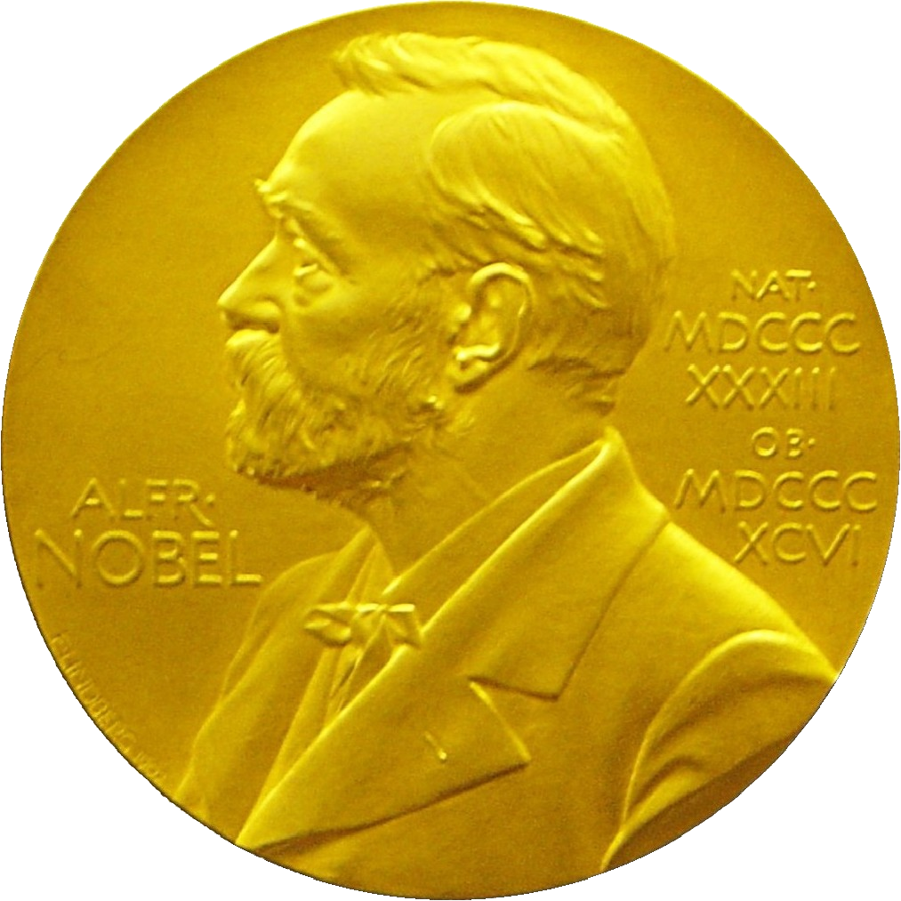
For more than 125 years…
IEEE has been the trusted source for researchers in academia, corporations, and government
Past and present IEEE Members include nearly two dozen Nobel Prize-winning innovators
Notes:
For over 125 years, IEEE has been the trusted source for researchers in academia, corporations, and government.
Each author becomes part of IEEE's stellar reputation. Past and present IEEE Members include nearly two dozen Nobel Prize-winning innovators.
Consistent quality and high demand have made IEEE the researcher's choice and the optimum publisher for authors around the world.

Slide 5
A milestone directly related to the credibility of content
IEEE Xplore surpassed
3 million documents
Authors add more than
1,000 articles daily
Notes:
In 2011, IEEE achieved a milestone that was directly related to the credibility of its content.
The IEEE Xplore digital library, one of the world’s largest collections of high quality technical literature in engineering and technology, surpassed three million documents.
Now, authors add more than 1,000 articles daily.

Slide 6
IEEE Society / Technical Council Worldwide Membership
(As of December 2013)
Region 10, 26%
Region 9, 5%
Regions 1-6, 47%
Region 8, 18%
Region 7, 4%
Region 8, 19%
Region 7, 4%
Region 9, 7%
Regions 1-6: USA
Region 8: Europe, Africa, Middle East
Region 10: Asia & Pacific
Region 7: Canada
Region 9: Latin America
Notes:
Emphasises the growth of region 10 in the future.

Slide 7
Societies and Technical Councils
Societies
Promote and foster technical communities within a specialized field of interest through conferences, publications, events, educational activities, and services
Technical Councils
Groups of Societies working together in a technical area across technological lines, disseminating knowledge through conferences, publications, events, educational activities, and services

Slide 8
Societies
Aerospace & Electronic Systems
Antennas & Propagation
Broadcast Technology
Circuits & Systems
Communications
Components, Packaging, & Manufacturing Technology
Computational Intelligence
Computer
Consumer Electronics
Control Systems
Dielectrics & Electrical Insulation
Education
Electromagnetic Compatibility
Electron Devices
Engineering in Medicine & Biology

Slide 9
Societies
Geoscience & Remote Sensing
Industrial Applications
Information Theory
Instrumentation & Measurement
Intelligent Transportation Systems
Engineering in Medicine & Biology
Geoscience & Remote Sensing
Industrial Applications
Information Theory
Instrumentation & Measurement
Intelligent Transportation Systems
Magnetics
Microwave Theory & Techniques
Nuclear & Plasma Sciences
Oceanic Engineering

Slide 10
Societies
Photonics
Power Electronics
Power & Energy
Product Safety Engineering
Professional Communication
Reliability
Robotics & Automation
Signal Processing
Social Implications of Technology
Solid-State Circuits
Systems, Man, & Cybernetics
Ultrasonics, Ferroelectrics, & Frequency Control
Vehicular Technology

Slide 11
Technical Councils
Biometrics
Electronic Design Automation
Nanotechnology
Sensors
Superconductivity
Systems
Technology Management

Slide 12
Society/Technical Council Chapters
Technical community within a specific geographic area
Consist of members from one or more IEEE Societies/Technical Councils who share technical interests and geographical proximity
Chapter activities include:
Guest speakers
Workshops
Seminars
Conferences
Tutorials
Foundation
Chapters are established via a petition and subsequent review

Slide 13
IEEE Sensors Council
IEEE Sensors Council
Founded in 1998 by 14 IEEE societies
Affiliated to 26 societies with >260000 membership
Objectives:
“.. to serve the sensor community with new publications, conferences, and technical committees. Its fields of interest and activities are the theory, design, fabrication, manufacturing, and application of devices for sensing and transducing physical, chemical, and biological phenomena, with emphasis on the electronics and physics aspects of sensors and integrated sensor-actuators..”

Slide 14
IEEE Regions
R1-6 IEEE-USA
R7 Canada
R8 Af, Eu, ME
R9 Latin America
R10 Asia, Pacific

Slide 15
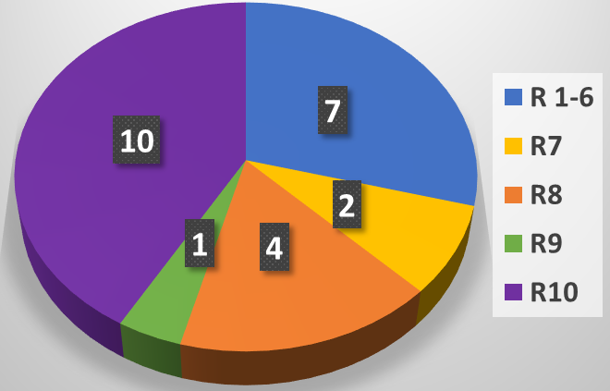
Chapters of the IEEE Sensors Council
16 Chapters
5 Joint Chapters
3 Student Branch Chapters
Spain
(2013)
UK and Ireland
(2015)
Italy
(2018)
France
(2018)

Slide 16
Italy Chapter IEEE Sensors Council
Italy
(2018)
Petition
Business plan
Signatures among the members
Endorsement
T. Tambosso
(Chair IEEE Sec Ita)
2 approvals
F. Labeau
(Council President)
M. Erikssen
(Op Com Director)
Spain
(2013)
UK and Ireland
(2015)
France
(2018)
Founders
Emiliano Schena (chair)
Calogero Oddo (vice chair)
Danilo Pani (treasurer)
Paola Saccomandi (secretary)

Slide 17
Italy Chapter IEEE Sensors Council
Italy
(2018)
Petition
Business plan
Signatures among the members
Endorsement
T. Tambosso
(Chair IEEE Sec Ita)
2 approvals
F. Labeau
(Council President)
M. Erikssen
(Op Com Director)
Spain
(2013)
UK and Ireland
(2015)
France
(2018)
Founders
Emiliano Schena (chair)
Calogero Oddo (vice chair)
Danilo Pani (treasurer)
Paola Saccomandi (secretary)

Slide 18
Italy Chapter IEEE Sensors Council
Business Plan
What was the motivating factor that led to forming this geographic unit? What member needs will be fulfilled as a result of forming this unit?
List the activities the unit will focus on for the first six months. What activities will engage the members of the unit with one another?
What accomplishments will this unit strive to meet in its first year?
What level of local support is engaged in support of the unit activities?

Slide 19
Italy Chapter IEEE Sensors Council
Italy
(2018)
Petition
Business plan
Signatures among the members
Endorsement
T. Tambosso
(Chair IEEE Sec Ita)
2 approvals
F. Labeau
(Council President)
M. Erikssen
(Op Com Director)
Spain
(2013)
UK and Ireland
(2015)
France
(2018)
Founders
Emiliano Schena (chair)
Calogero Oddo (vice chair)
Danilo Pani (treasurer)
Paola Saccomandi (secretary)

Slide 20
Italy Chapter IEEE Sensors Council
Italy
(2018)
Petition
Business plan
Signatures among the members
Endorsement
T. Tambosso
(Chair IEEE Sec Ita)
2 approvals
F. Labeau
(Council President)
M. Erikssen
(Op Com Director)
Spain
(2013)
UK and Ireland
(2015)
France
(2018)
Founders
Emiliano Schena (chair)
Calogero Oddo (vice chair)
Danilo Pani (treasurer)
Paola Saccomandi (secretary)

Slide 21
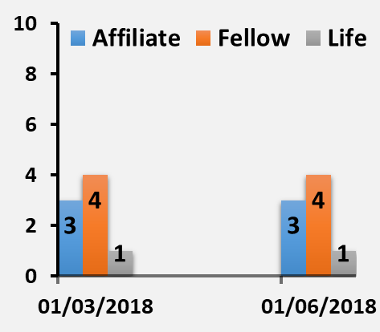
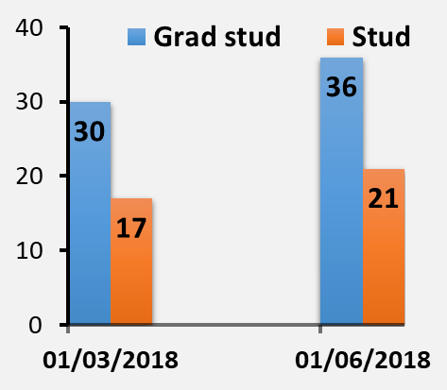
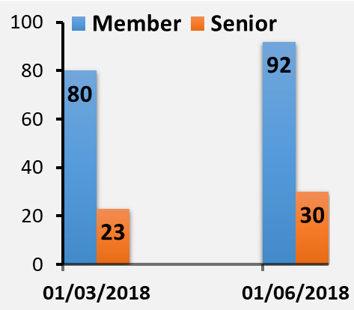
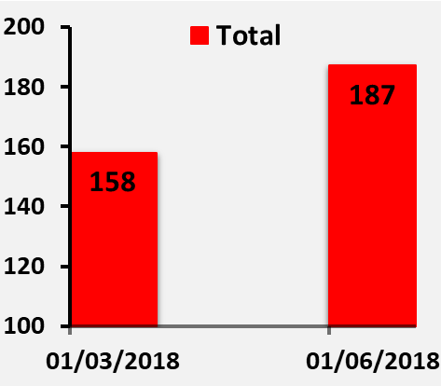
Chapter Data
Data (May 29, 2018)
21 Student
36 Graduate student
3 Affiliate
92 member
30 Senior
4 fellow
1 life fellow
Total 187

Slide 22
Chapter Organization
Chapter ExCo
IEEE Italy Section
Committees
Services
(website management, …)

Slide 23
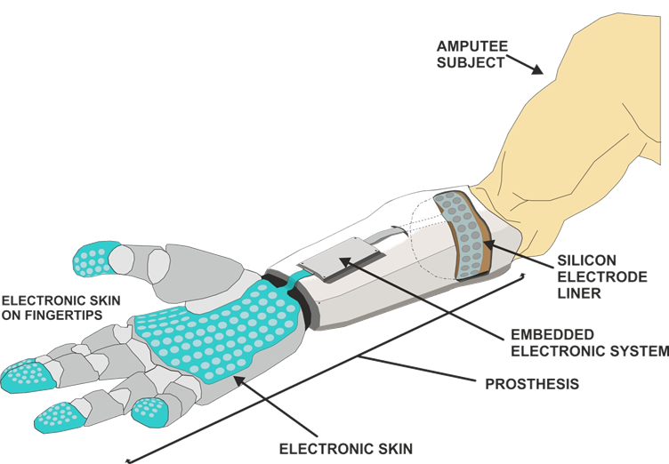
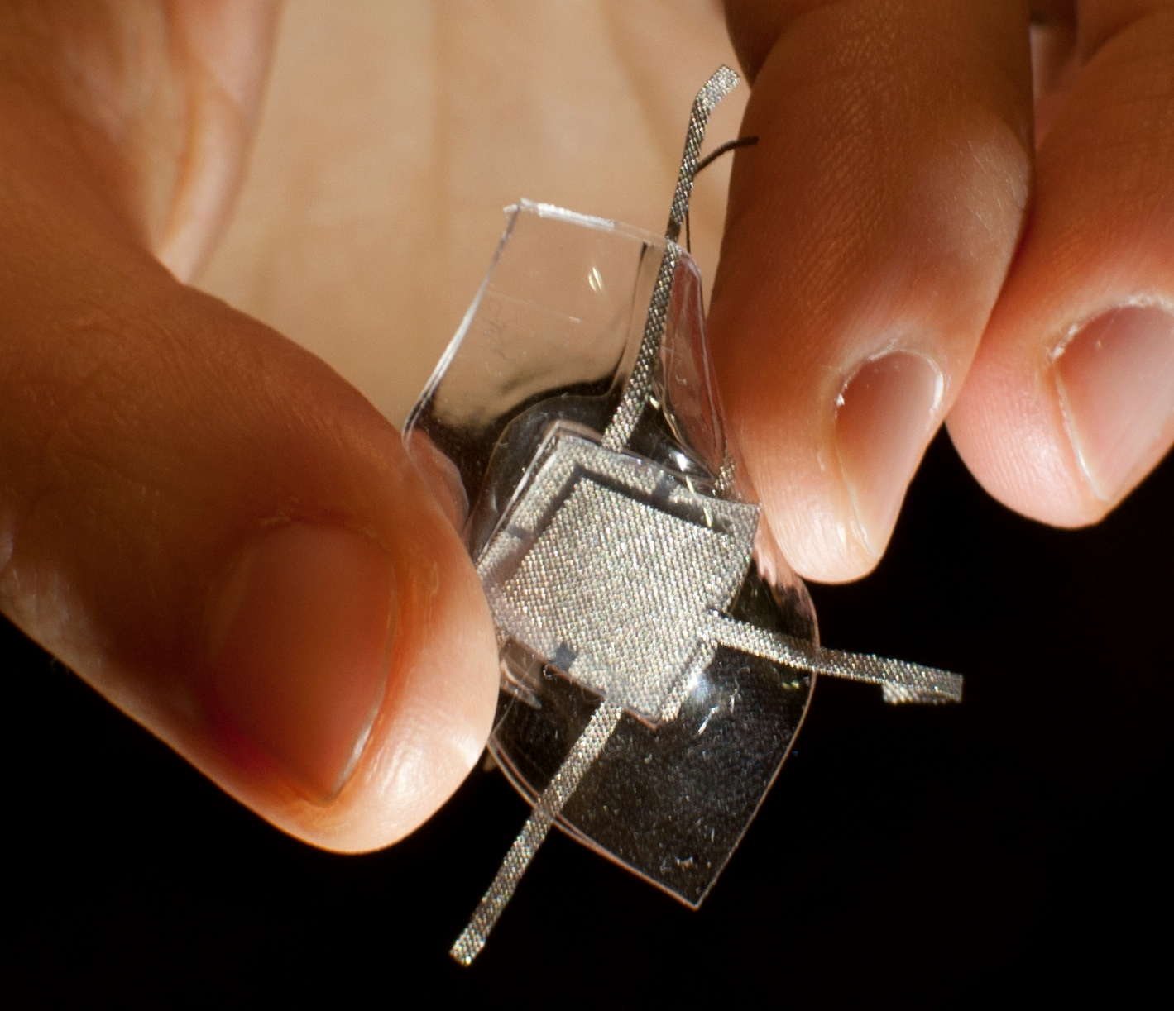
Chapter Taxonomy
Technology
Application
Measurand

Slide 24
Technical Committees: Objectives
To maintain a database of persons, institutions, contacts of the scientific community related to the chapter, in academia, research centers and industries
To propose awards and evaluate the applications
To organize activities and initiatives
To serve as a reference point within the activities towards the definition of international technical standards in the sensors domain (link with IEEE Standards Association)

Slide 25
Technical Committees of our Chapter: Examples of active committees
Wearable sensors
Ultrasound sensors
Soft sensors
Textile sensors
Physiological sensors
Biosensors
Nanosensors
Fiber optic sensors
Sensors for biomechanics
Tactile sensors
Vibration and acoustic sensors
Sensing systems
Smart sensors & edge computing
Chemical sensors development and applications
Inertial Measurement Unit
Electronic Interfaces and Signal Processing for Sensors

Slide 26
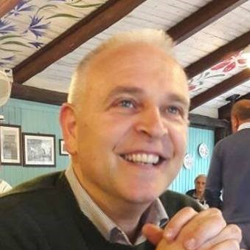
Technical Committees of our Chapter: Examples of active committees
Electronics for sensors
SCOPE
…This technical commission will take in deep consideration innovation aspects of the electronic interfaces as well as new ideas, even expressed at theoretical level, of detection-interface paradigms. Other scopes are: dissemination of the latest news on the research topics of ELECTRONICS FOR SENSORS, improving the dialogue and promote cohesion and collaboration among research groups as well as the organization of technical events, evaluation of award candidates and activation of a fruitful interaction with the industrial world…
Chair
Giuseppe Ferri was born in L’Aquila, Italy. He received the “Laurea” degree (cum laude) in electronic engineering in 1988. In 1991, he joined the Department of Electronic Engineering, University of L’Aquila, L’Aquila, Italy, where he is actually a full professor of Electronics and Microelectronics. His research activity mainly concerns the design of analogue electronic circuits for sensor and biomedical applications both in voltage and in current mode…

Slide 27
Activities for the first year: Plan
Founding Assembly
Periodic EXCo Meetings (monthly) and with chairs of technical committees (3-months)
Start-up and maintenance of website
Newsletter
Distinguished Lecturers
Meeting with industry representatives to start consultations about standards of relevant national interest
Chapter organization and participation for events relative to different sectors of interest (international schools and conferences)

Slide 28
Activities for the first year: Results so far (organization/support)
Distinguished Lectures (7)
V. Lumelsky “Whole-body sensing in robotic systems operating in an unstructured environment”
V. Lumelsky “Human-Robot Interaction and Human-Robot Teams”
D. Stratos “Nuclear Medicine Instrumentation: SPECT and PET technologies”
M. Nikl “Inorganic scintillation materials: R&D state-of-art and trends”
K. Taesung “Development of Optical Fiber Sensors for Various Applications”
D. Tosi “Fiber optic sensors for real-time medical diagnostic and treatments: towards new multiplexing and spatial resolution limits”
A.P. Silvatti “Breathing biomechanics: optical measurement systems for thoracoabdominal analysis”
International summer schools (3)
2018/07/02-07, Pula. “Technologies and signal processing in perinatal medicine”
2018/07/23-27, Bressanone. “Summer School of Information Engineering (SSIE)”
2018/09/17-21, Alghero. “CPS Summer School 2018: Designing Cyber-Physical Systems – From concepts to implementation”

Slide 29
Activities for the first year: Results so far (organization/support)
International Conferences/Workshops (4)
2018/06/11-13, Roma. 2018 IEEE International Symposium on medical measurements & applications (MeMeA)
2018/06/14, Novi Sad. Italian-Serbian Collaboration Platform in Advanced Manufacturing (ISCP) Annual Conference
2018/06/18, Torino. Laser-enabled mini-invasive treatments of tumors: from thermal ablation to photo-dynamics therapies
2018/09/26, Roma, First Workshop on Electronics for Sensors
2018/10/08-10, Bari. 2018 IEEE International Workshop on metrology for the Sea
Officers Meetings (2)
2018/02/06, call. Planning activities
2018/06/13, Roma. Planning activities
Founding Assembly (1)
2018/02/16, Pontedera. Chapter presentation and elections
Ex Co Meetings (3)
2018/04/06, call. Meetings among all officers and chairs of technical committees
2018/05/31, call. Meetings among all officers and chairs of technical committees
2018/06/26, call. Meetings among all officers and chairs of technical committees

Slide 30
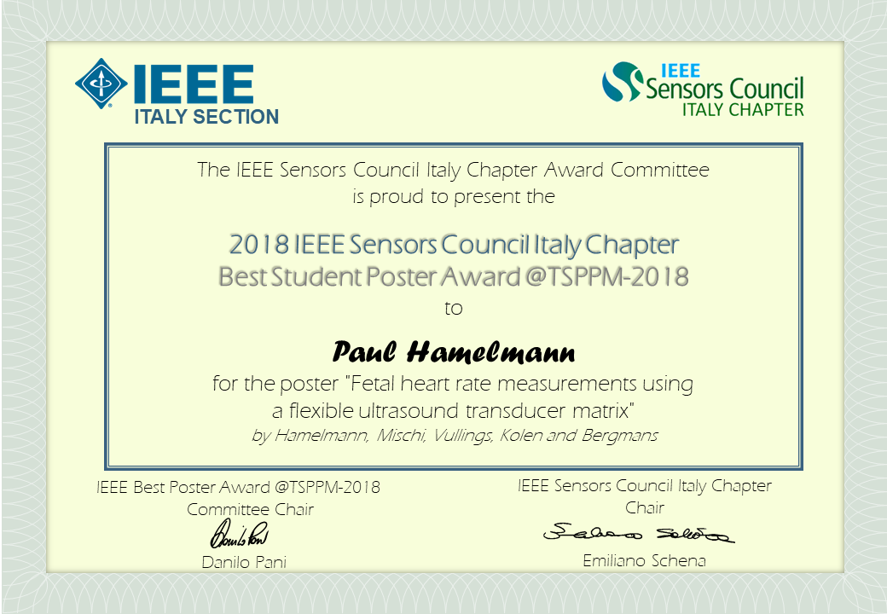
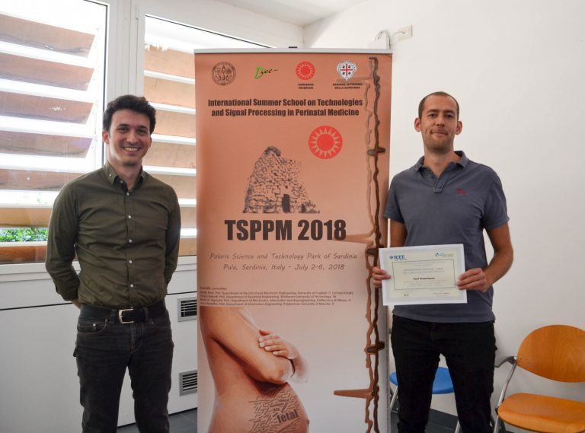
Activities for the first year: Results so far (organization/support)
Awards (2)
2018/07/02-07, Pula. “Technologies and signal processing in perinatal medicine”, assigned to Paul Hamelmann, Eindhoven University of Technology, for the abstract and poster “Fetal heart rate measurements using a flexible ultrasound transducer matrix”
2018/10/08-10, Bari. 2018 IEEE International Workshop on metrology for the Sea. Award to be assigned to the “Best Student Paper”. Submissions are open!

Slide 31
Activities for the first year: Results so far (organization/support)
Special Issue (1)
We are organizing a special issue on State of the Art of Sensors in Italy, to be hosted by the IEEE Sensors Journal. Be ready to submit papers!
Open positions

Slide 32
Paola Saccomandi
paola.saccomandi@polimi.it
Politecnico di Milano
Emiliano Schena
e.schena@unicampus.it
Università Campus Bio-Medico di Roma
Calogero Oddo
calogero.oddo@santannapisa.it
Scuola Superiore Sant’Anna
Danilo Pani
danilo.pani@diee.unica.it
Università di Cagliari
http://sites.ieee.org/italy-sensors/

Slide 33
Italy Chapter of the IEEE Sensors Council: objectives and opportunities for students and a case study on the combined use of force, ultrasound and vision sensors for anatomopathological analyses in the IMEROS project
Calogero Maria Oddo
calogero.oddo@santannapisa.it
Bressanone, July 26, 2018

